Slide 1
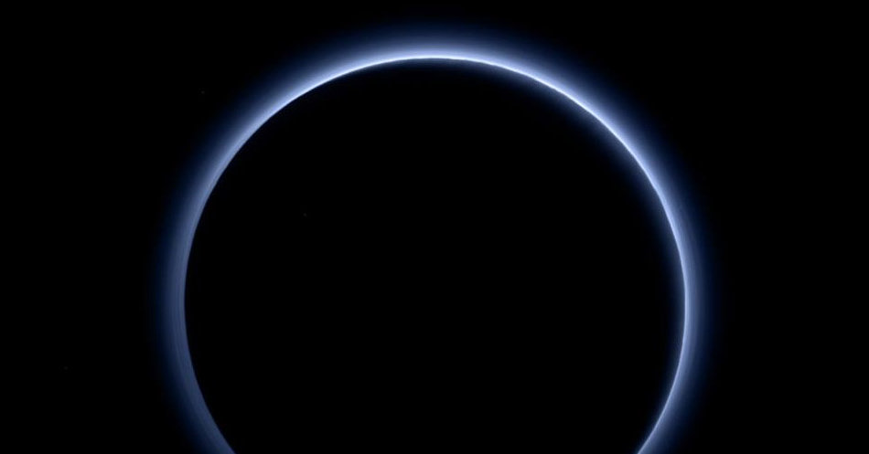




Robotic Exploration of the Solar System
Authors:
Yi Qiang Ji Zhang
Rita da Cruz Fardilha
Èric Montserrat Robles
Ivan Sermanoukian Molina
Professor/s:
Manel Soria
Arnau Miró
Elena Terzic

Slide 2
Table of contents
Introduction
A2- SPICE Assignment
A3- Image Processing Assignment
A4- Remote Sensing of Earth Assignment
A6- Remote Sensing of Earth Project
A5- Image Navigation project
Conclusions
References

Slide 3
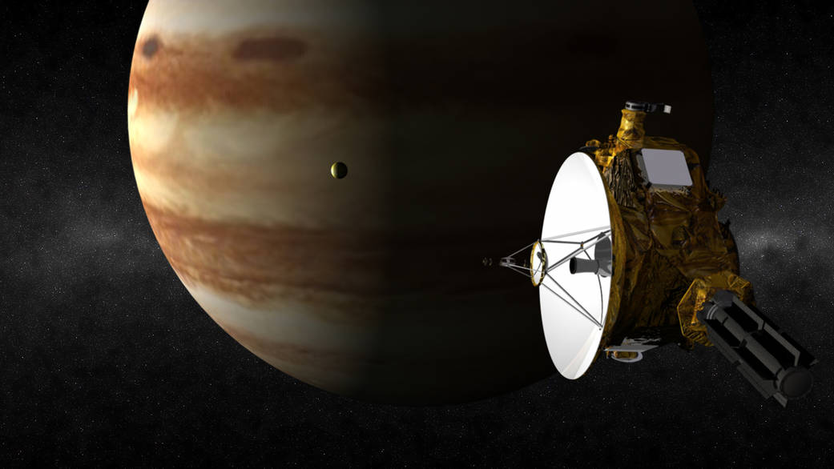
New Horizons flybly across Jupiter and Pluto systems
A2 – SPICE Assignment
[1] Jupiter Flyby https://www.nasa.gov/mission_pages/newhorizons/images/index.html

Slide 4
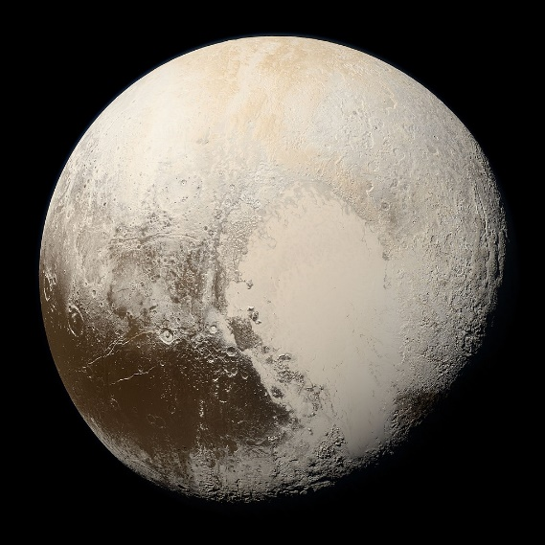
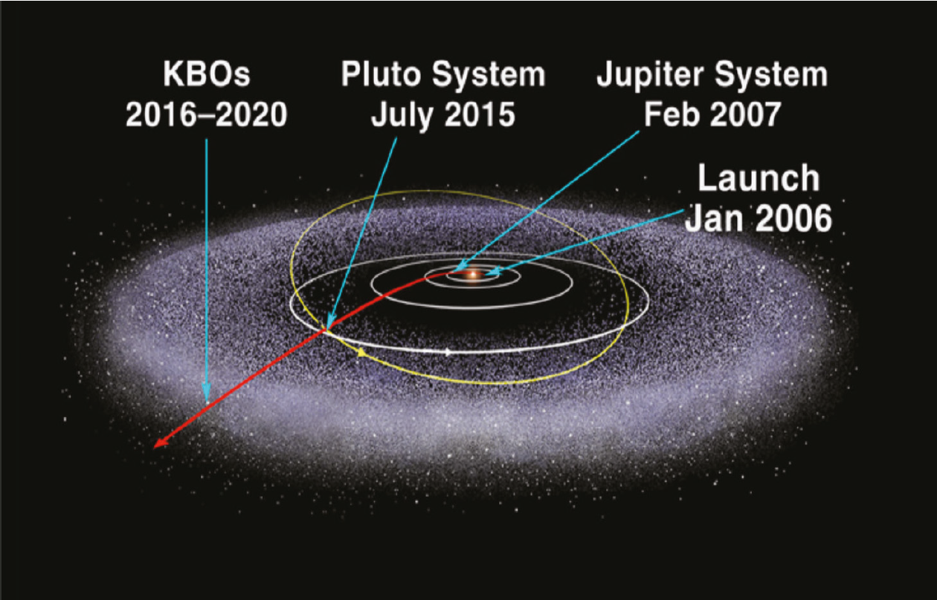
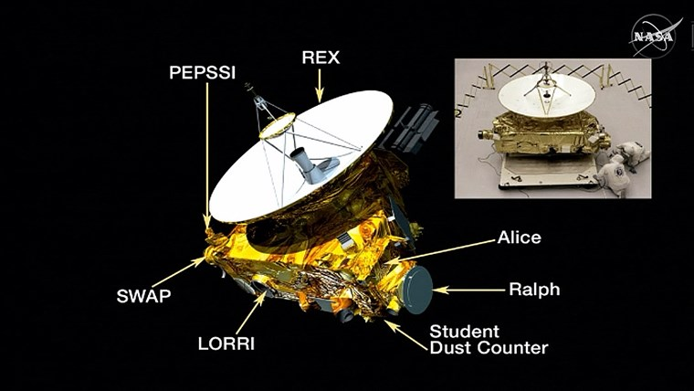
New Horizons
NASA's New Horizons spacecraft is the first spacecraft to explore Pluto up close, flying by the dwarf planet and its moons on July 14, 2015. In early 2019 , New Horizons flew past its second major science target—2014 MU69, the most distant object ever explored up close.
Pluto's image taken by New Horizons on July 14, 2015 [3]
New Horizons trajectory [1].
New Horizons spacecraft [2].
[1] Stern, A., & Grinspoon, D. (2018). Chasing New Horizons: Inside the Epic First Mission to Pluto. Picador.
[2] NBC News. NASA’s New Horizons probe gives us first look in person https://www.nbcnews.com/science/space/nasas-new-horizons-probe-gives-us-our-first-look-person-n379781 [3] NASA. Pluto image. http://pluto.jhuapl.edu/Galleries/Featured-Images/image.php?page=1&gallery_id=2&image_id=543
Notes:
https://upload.wikimedia.org/wikipedia/commons/e/ee/New_Horizons_spacecraft_model_1.png
https://www.google.com/url?sa=i&url=https%3A%2F%2Fwww.pinterest.com%2Fpin%2Fthe-most-spectacular-gif-and-video-of-pluto-ever-taken--121175046201275101%2F&psig=AOvVaw2o-9VTT8c3jHg5UFCOUQZJ&ust=1622537142896000&source=images&cd=vfe&ved=0CA0QjhxqFwoTCPjir4jQ8_ACFQAAAAAdAAAAABAT

Slide 5
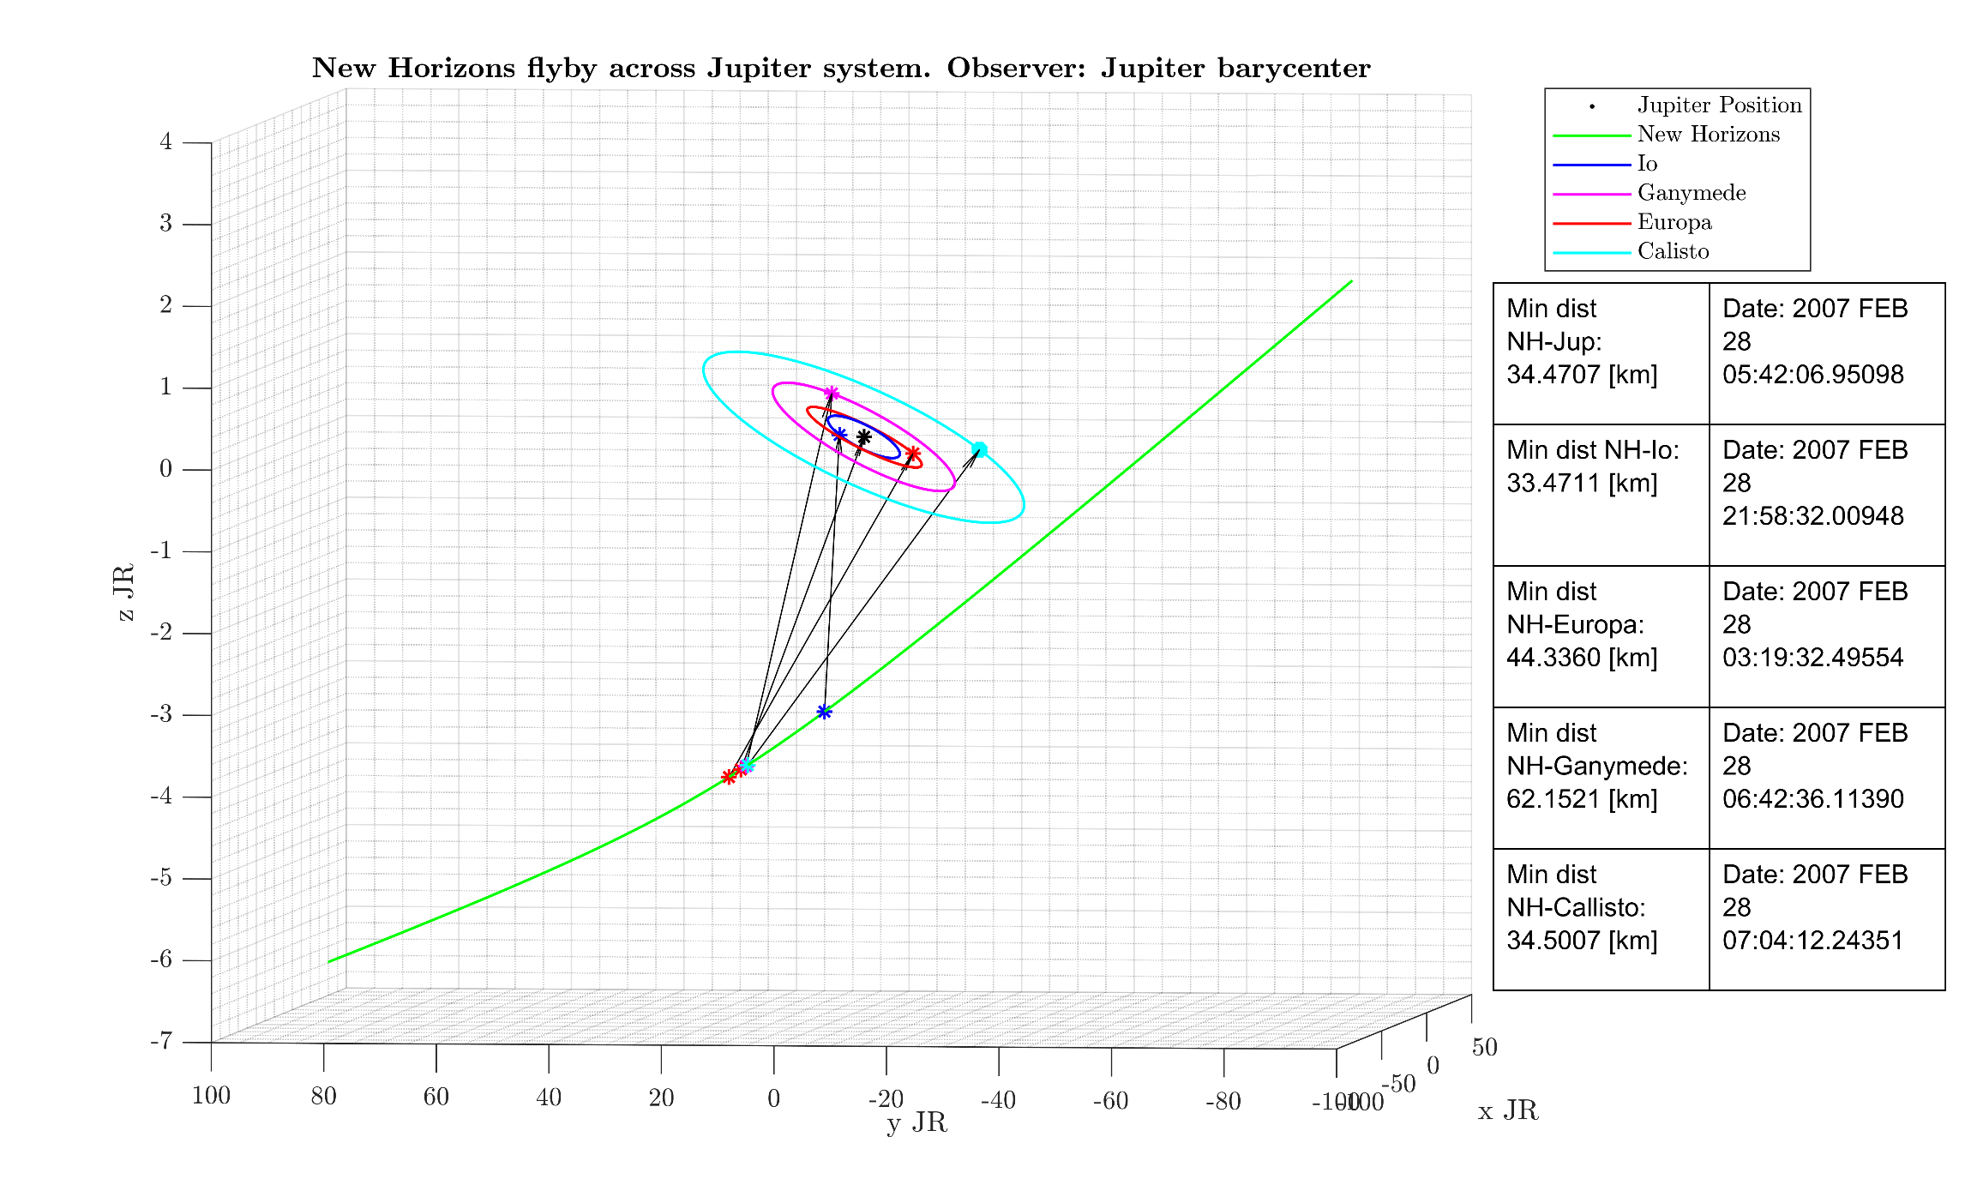
New Horizons flyby across Jupiter system
Parameters
Ecliptic plane J2000
Aberration Correction = None
Observer = Jupiter barycentre “5”
Notes:
https://www.sciencedirect.com/topics/computer-science/chaotic-systems

Slide 6
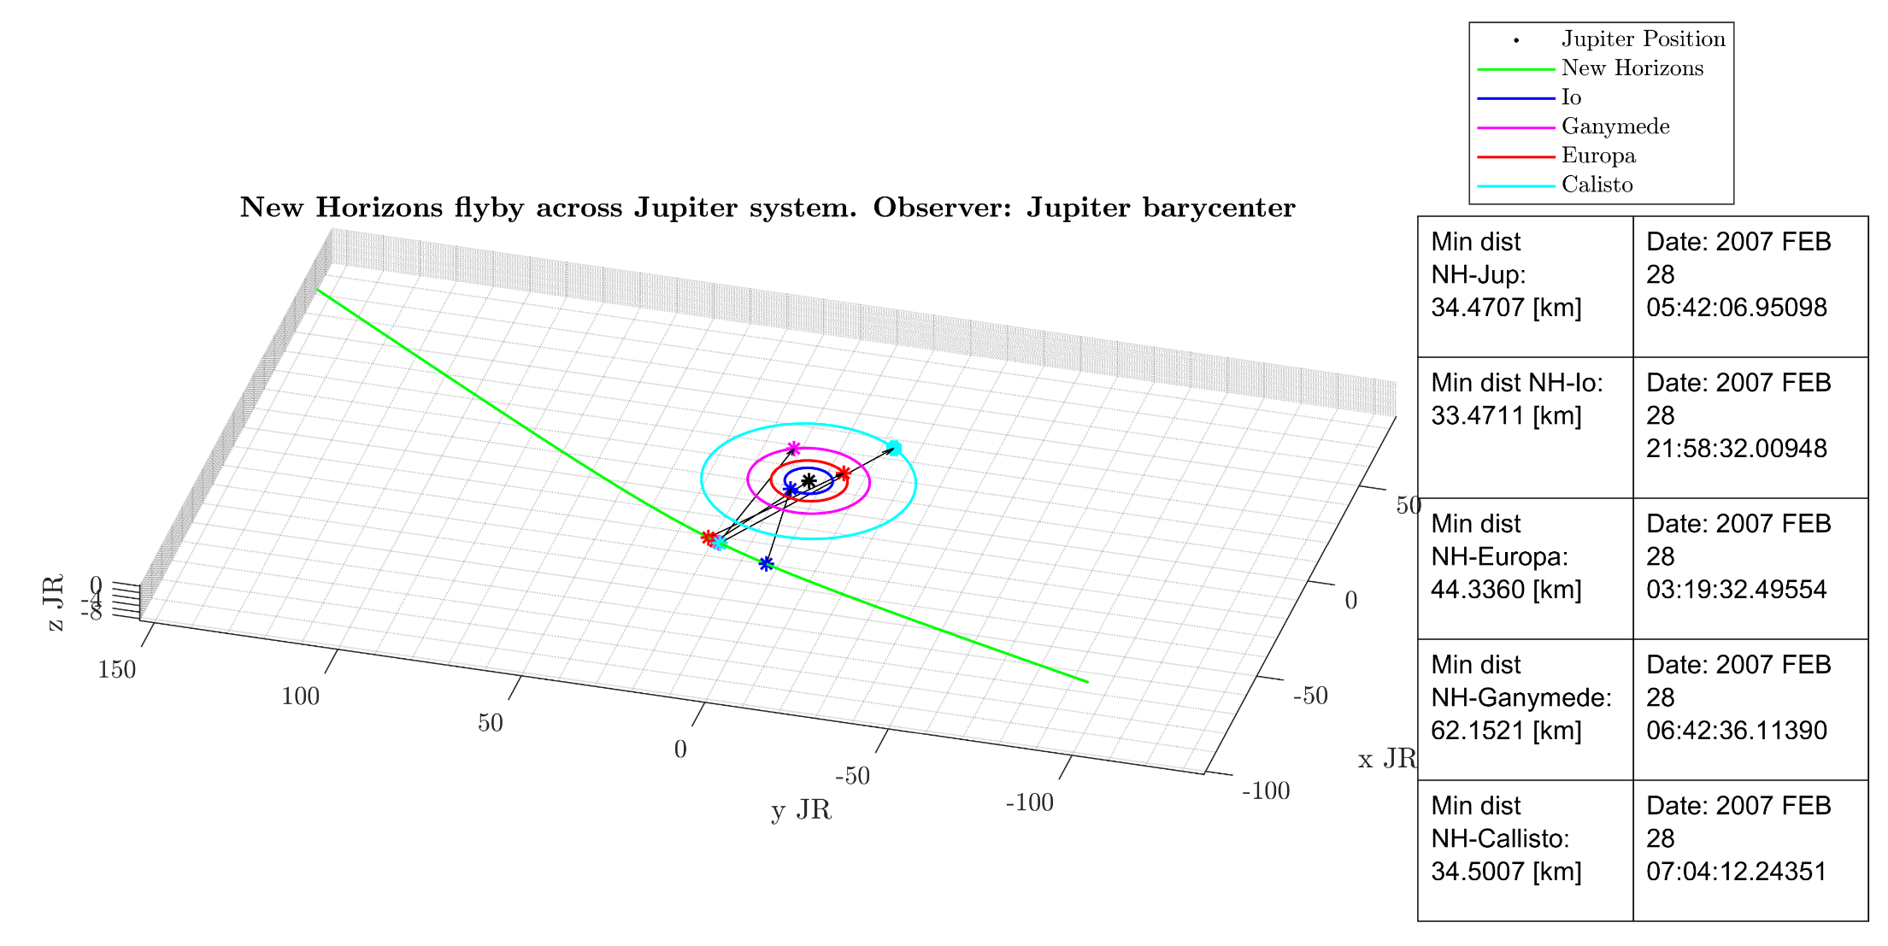
New Horizons flyby across Jupiter system
Parameters
Ecliptic plane J2000
Aberration Correction = None
Observer = Jupiter barycentre “5”
Notes:
https://www.sciencedirect.com/topics/computer-science/chaotic-systems

Slide 7
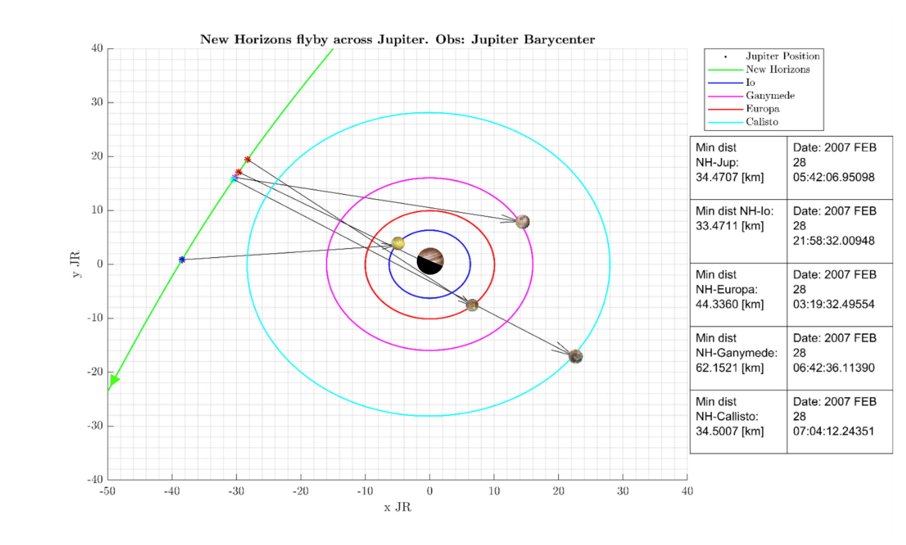
New Horizons flyby across Jupiter system
Parameters
Ecliptic plane J2000
Aberration Correction = None
Observer = Jupiter barycentre “5”
(Planets and satellites are not to scale)
Sun’s position can be deduced from the shadow of Jupiter
Notes:
https://www.sciencedirect.com/topics/computer-science/chaotic-systems

Slide 8
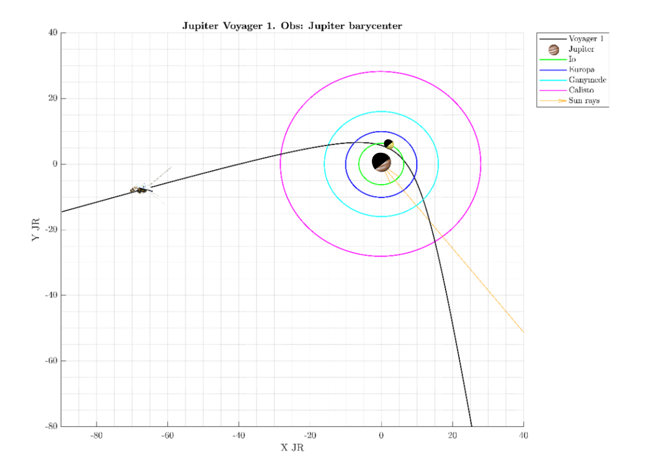
New Horizons flyby across Jupiter system
Parameters
Ecliptic plane J2000
Aberration Correction = None
Observer = Jupiter barycentre “5”
(Planets and satellites are not to scale)
Notes:
https://www.sciencedirect.com/topics/computer-science/chaotic-systems

Slide 9
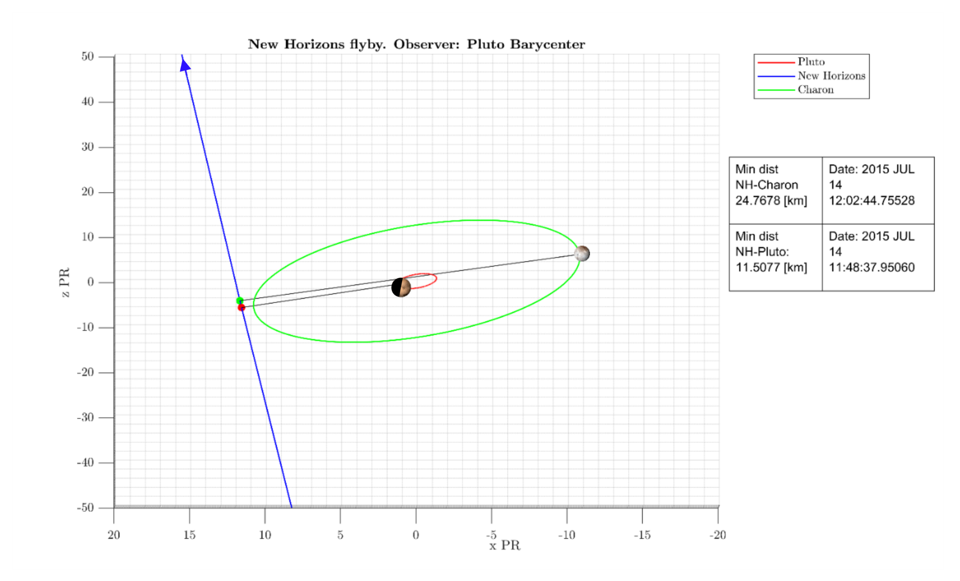
New Horizons encounter with Pluto system
Parameters
Ecliptic plane J2000
Aberration Correction = None
Observer = Pluto barycentre “9”
(Planets and satellites are not to scale)
Sun light direction is not plotted, the vector can't be properly
scaled due to the distance between the Sun and Pluto.
However, we extracted the information and represented the shadow
Notes:
https://www.sciencedirect.com/topics/computer-science/chaotic-systems

Slide 10
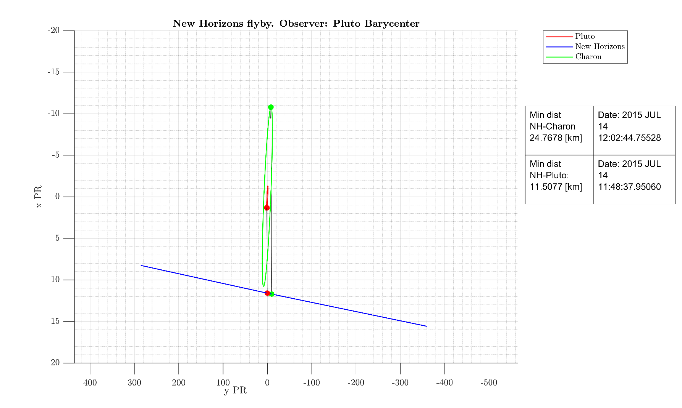
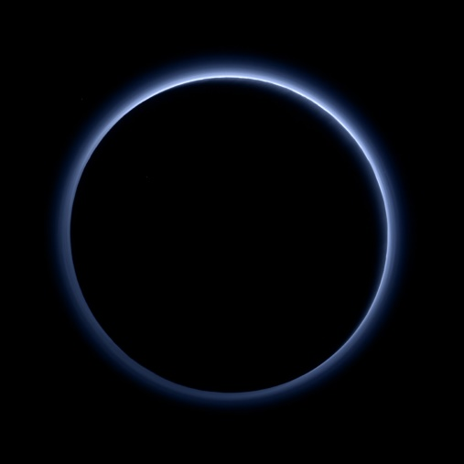
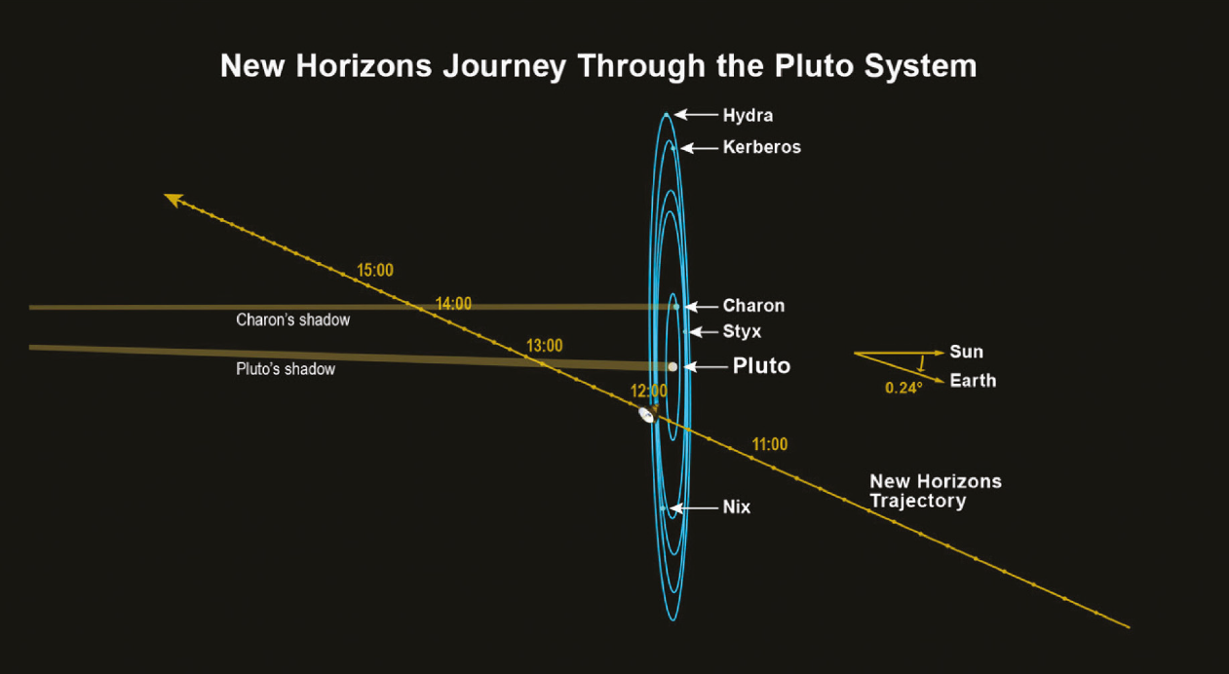
New Horizons encounter with Pluto system
Parameters
Ecliptic plane J2000
Aberration Correction = None
Observer = Pluto barycentre
(Planets and satellites are not to scale)
Pluto [1]
[1] Talbert, Tricia (2015). New Horizons Image Gallery. https://www.nasa.gov/mission_pages/newhorizons/images/index.html [2} Stern, A., & Grinspoon, D. (2018). Chasing New Horizons: Inside the Epic First Mission to Pluto. Picador.
New Horizons Journey [2]
Notes:
Cite the book

Slide 11
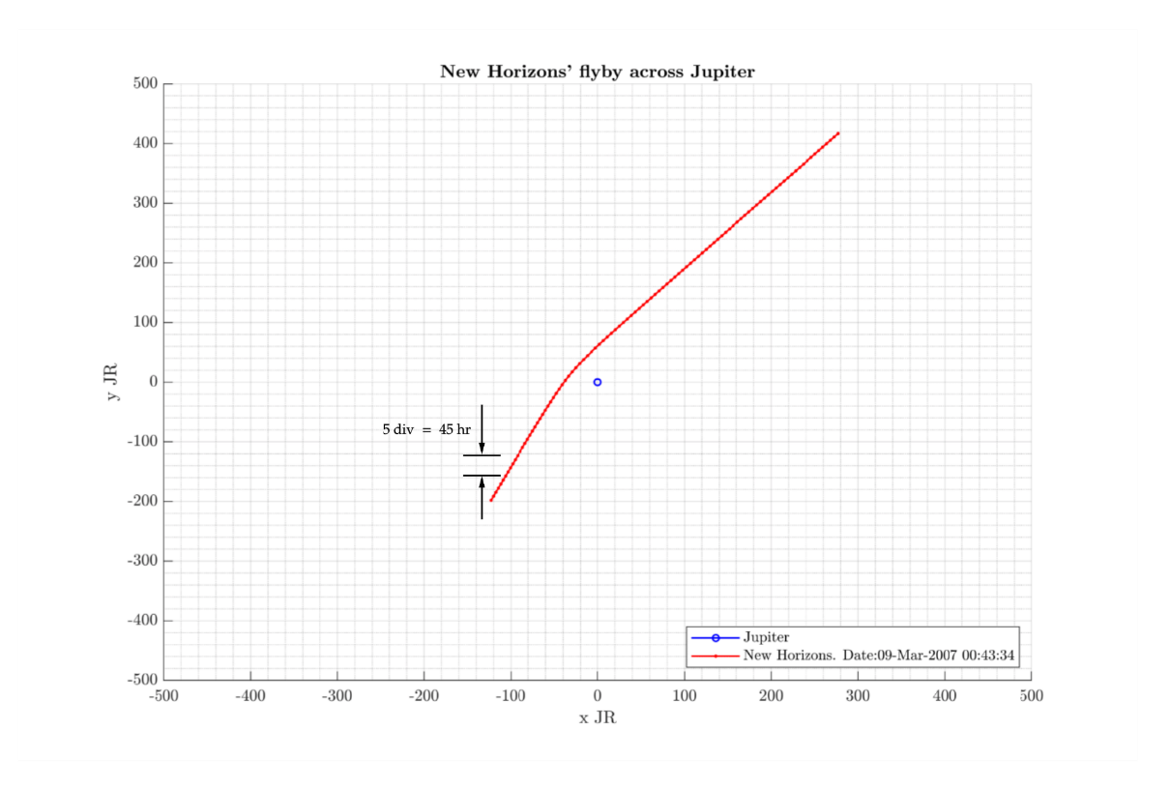
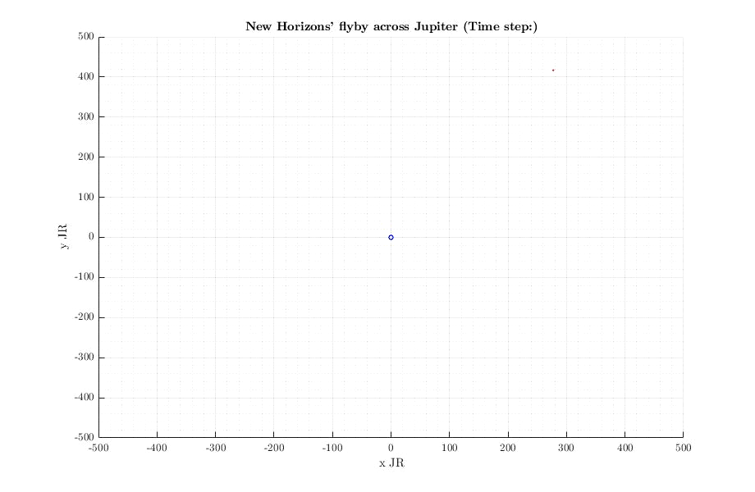
New Horizons flyby across Jupiter
Parameters
Ecliptic plane J2000
Aberration Correction = None
Observer = Jupiter barycentre
(Planets and satellites are not to scale)
Notes:
https://www.sciencedirect.com/topics/computer-science/chaotic-systems

Slide 12
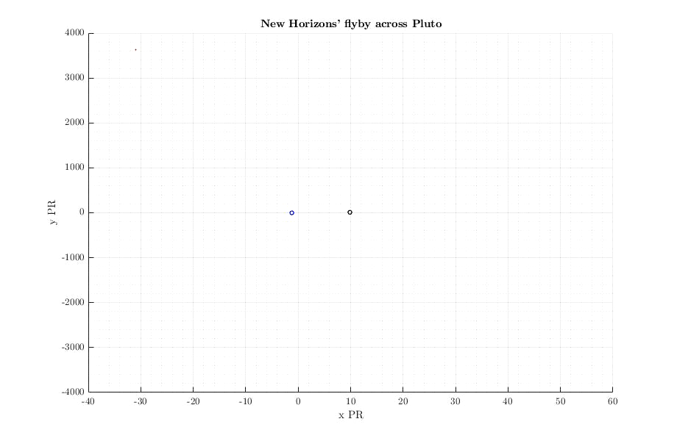
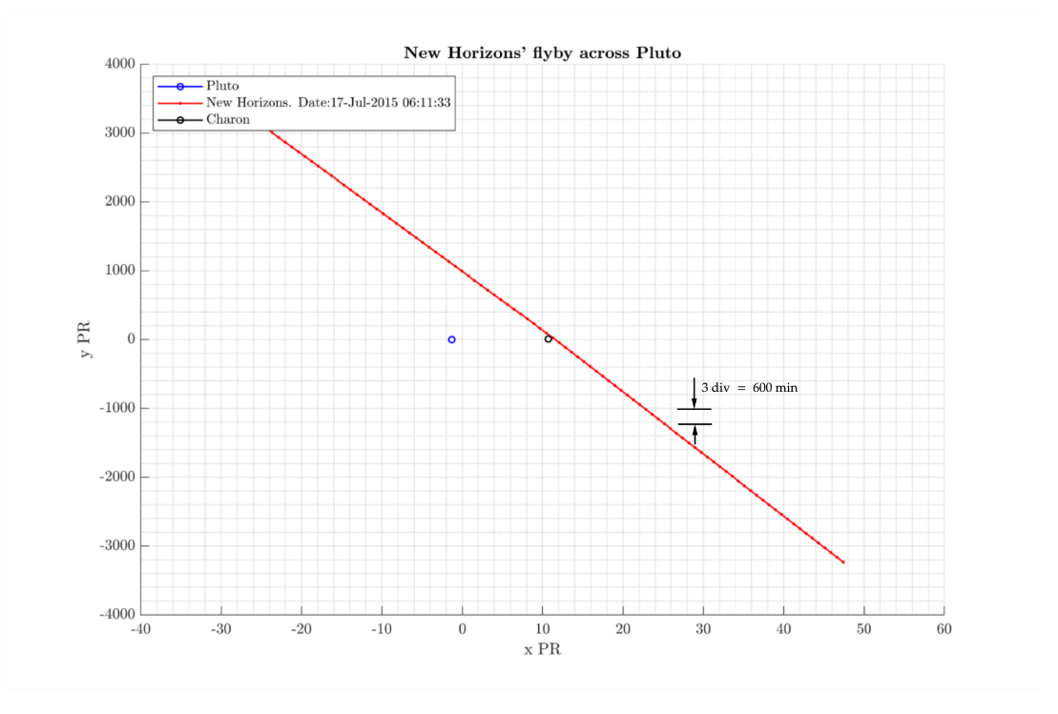
New Horizons flyby across Jupiter
Parameters
Ecliptic plane J2000
Aberration Correction = None
Observer = Pluto barycentre
(Planets and satellites are not to scale)
Notes:
https://www.sciencedirect.com/topics/computer-science/chaotic-systems

Slide 13
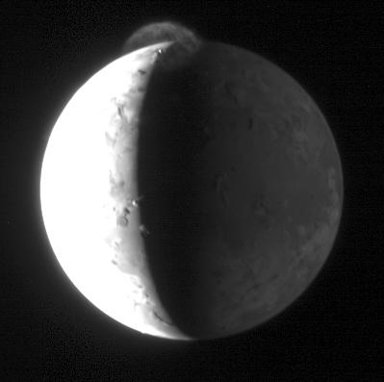
“Re-discover” Linda Morabito’s volcanic plume on Io
A3 – Image Processing Assignment
[1]https://photojournal.jpl.nasa.gov/catalog/PIA09360

Slide 14
A3- Image Processing Workflow to reveal the plume
GEOMED image in binary format
2- Increase local brighten
1- Improve contrast
4-Increase exposure dark areas
3- Adjust local contrast
5-Adjust overall contrast
6-Sharpen small details
Convert image into a suitable format with
VICARREAD5
7- Convert into uint16 and save
Re-run until the result is acceptable
Provoke small changes
to avoid:
Loss of detail
Image burning
Convert uint16 into double format
Notes:
https://www.sciencedirect.com/topics/computer-science/chaotic-systems

Slide 15

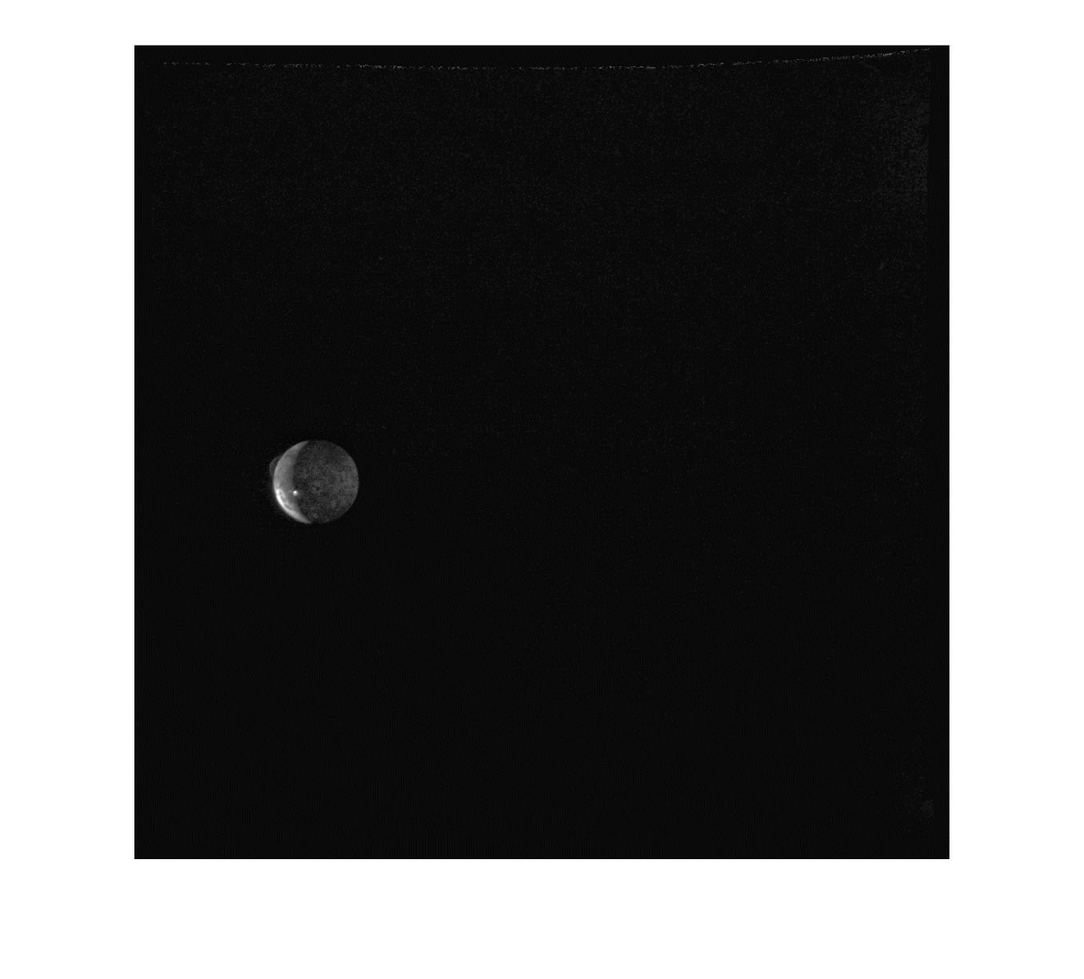
Io’s plume re-discovered
GEOMED [1]
GEOMED PROCESSED
[1] Planetary Data System
Url: https://pds-rings.seti.org/holdings/volumes/VGISS_5xxx/VGISS_5118/DATA/C16481XX/C1648109_GEOMED.IMG
Notes:
https://www.sciencedirect.com/topics/computer-science/chaotic-systems

Slide 16
Io’s plume re-discovered
Zoom In - GEOMED PROCESSED
Notes:
https://www.sciencedirect.com/topics/computer-science/chaotic-systems

Slide 17
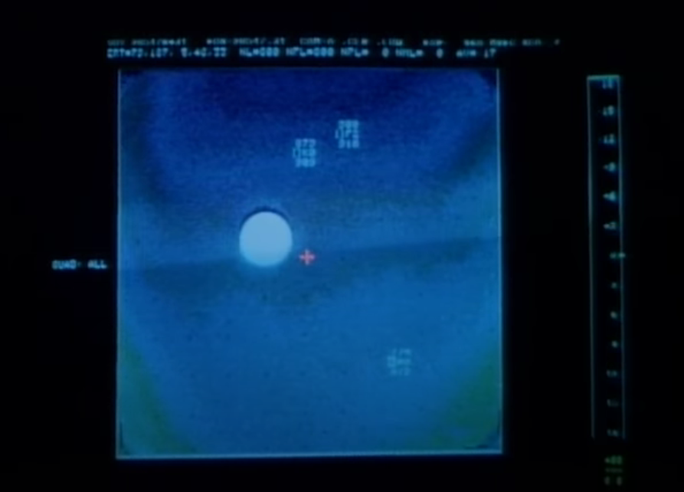
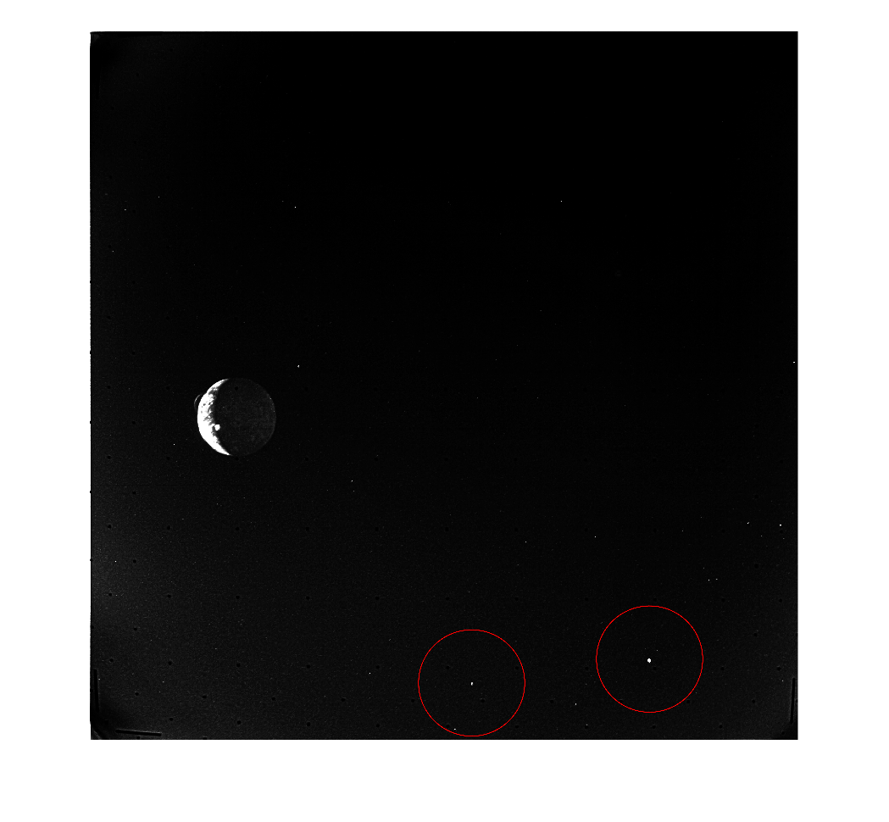
Stars?
Io Plumes [1]
RAW image processed
Cases:
Video image is flipped and the upper located stars are the bottom stars in our image.
The image is not flipped and the lower star from the video is one of the marked points in our image
The points marked in our image are noise and do not correspond to any star.
Notes:
https://www.sciencedirect.com/topics/computer-science/chaotic-systems

Slide 18
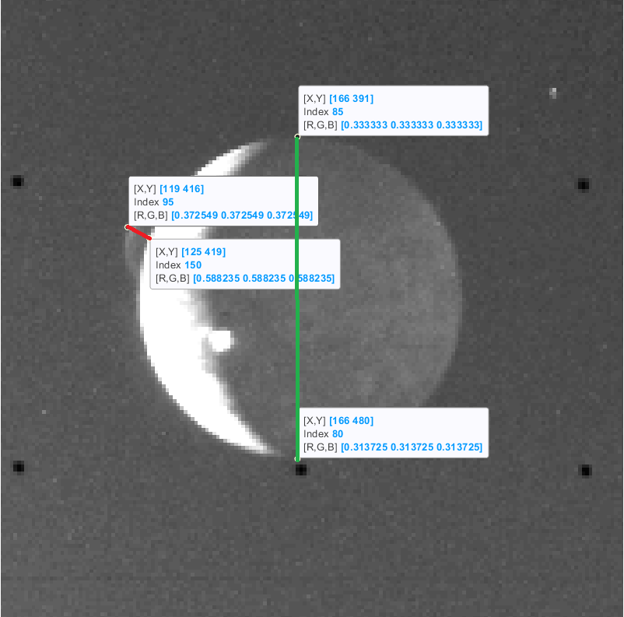


Plume elevation
The diameter of Io is 3643.2km (2×radius of 1821.6km)
The distance in green is equal to 480−391 = 89 pixels.
$$Plume pixels=\sqrt{{\left(125−119\right)}^{2}+{\left(419−416\right)}^{2}}=6.7082 pixels$$
Plume elevation = $\frac{6.7082x3643.3}{89}$=274.599km
Error = $\frac{\left|274.599−260\right|}{\left|260\right|}$ x 100 = 5.6%
Notes:
https://www.sciencedirect.com/topics/computer-science/chaotic-systems

Slide 19
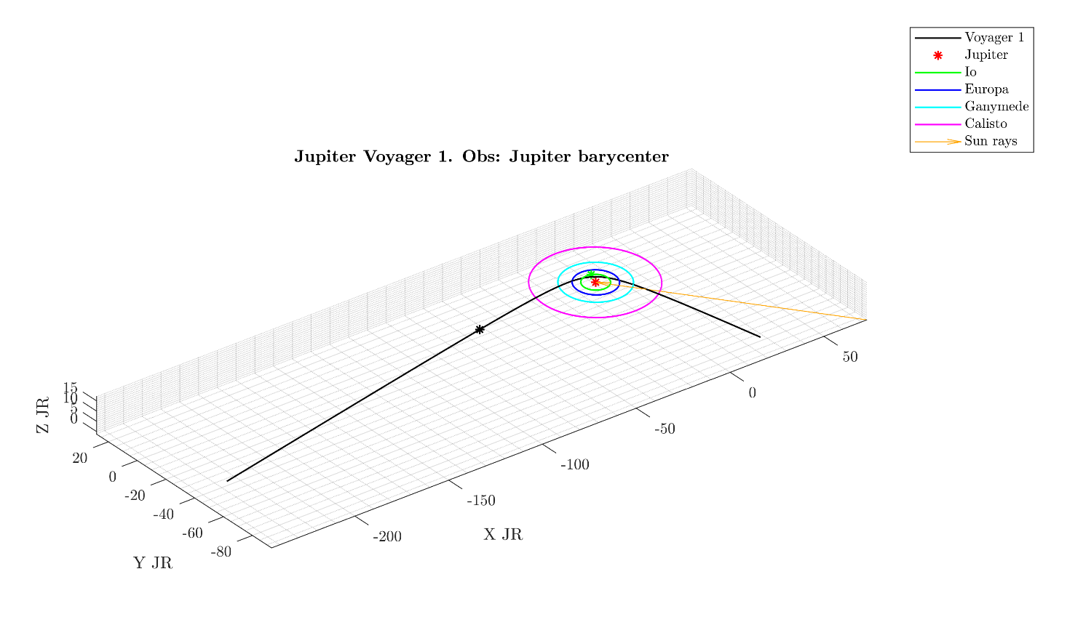
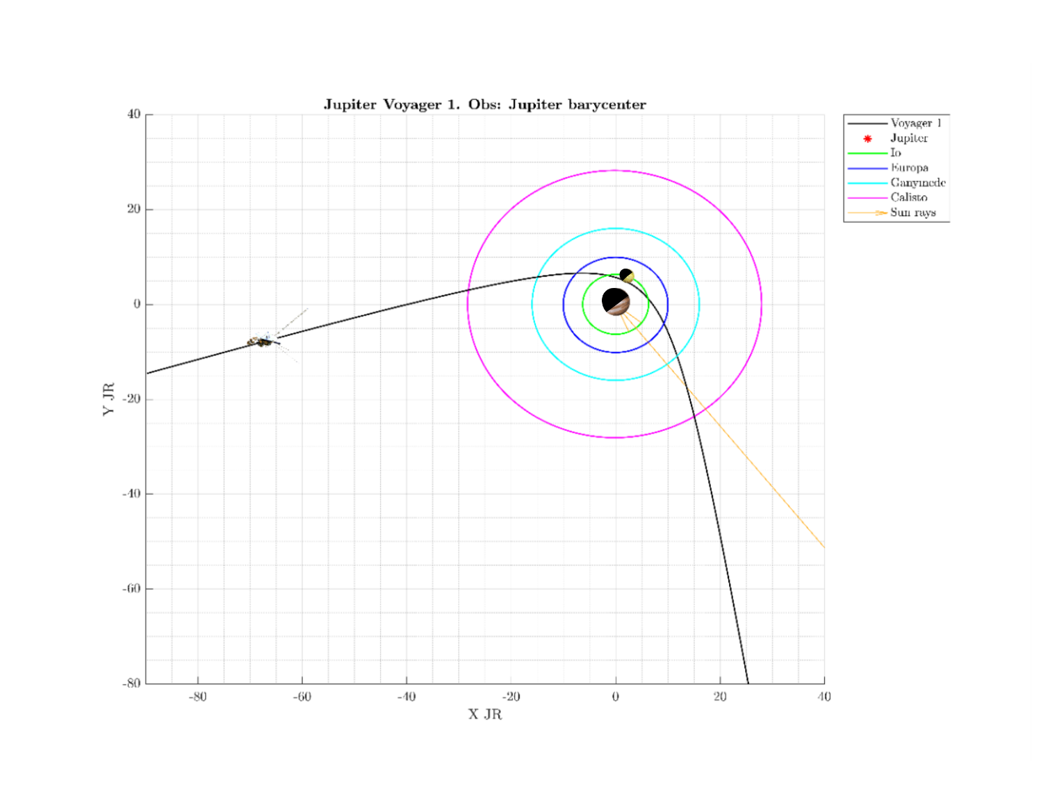
Overall situation
The volcanic eruption seen by Voyager 1 in Io showed that the ash cloud was catching the rays of the rising sun.
Therefore, the dark hemisphere of Io is made visible by light reflected from Jupiter.
Parameters
Ecliptic plane J2000
Aberration Correction = None
Observer = Jupiter barycentre “5”
The Voyager 1 position corresponds to March 8 1979, when the picture of Io was taken.
Notes:
https://www.sciencedirect.com/topics/computer-science/chaotic-systems

Slide 20
“It was the stuff of dreams, because I knew I was seeing something that most likely no human being had ever seen before.” Linda Morabito

Slide 21
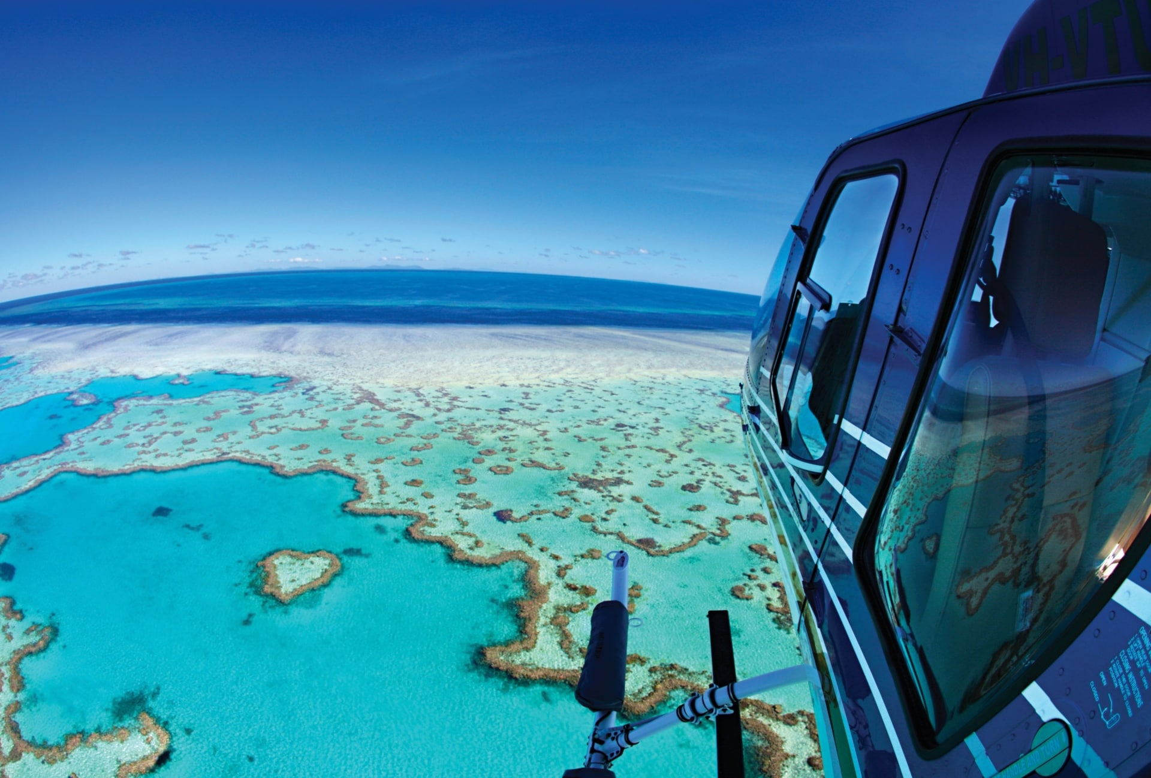
Remote Sensing of Earth Assignment and Project (A4 and A6)
“Australia's Great Barrier Reef has lost more than half of its corals since 1995 due to warmer seas driven by climate change, a study has found.”
https://www.australia.com/en/things-to-do/beaches-and-islands/australias-coral-reefs.html
Notes:
https://www.sciencedirect.com/topics/computer-science/chaotic-systems

Slide 22
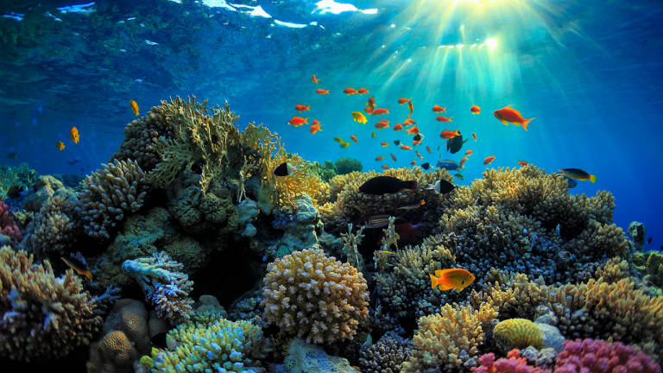
Reasons of Interest
World’s largest living structure and, in fact, it is so large that it can be seen from space.
Home for a massive amount of species.
Great Barrier Reef [1]
[1] https://whywander.com/trips/great-barrier-reef-australia/
Notes:
https://www.sciencedirect.com/topics/computer-science/chaotic-systems

Slide 23
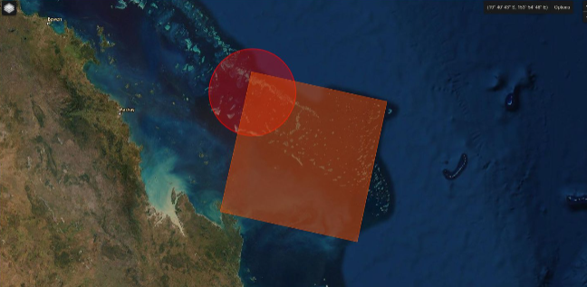
Problem definition for the Assignment
Evaluate different aspects in this region of the Great Barrier Rief in Australia:
Natural Colour
Infrared
Normalized Difference Vegetation Index (NDVI)
Remote Sensing Reflectance (Rrs)
Temperature
Water Mask
Cloud Mask
Geolocalized temperature map
Turbidity
Chlorophyll
Notes:
https://www.sciencedirect.com/topics/computer-science/chaotic-systems

Slide 24
Data Source for the Assignment
Latitude: -20.87421043965721
Longitude: 150.9466552734375
Path: 092
Row: 074
Date: 2021/03/05
ID: LC08_L2SP_092074_20210305_20210312_02_T1
Notes:
https://www.sciencedirect.com/topics/computer-science/chaotic-systems

Slide 25
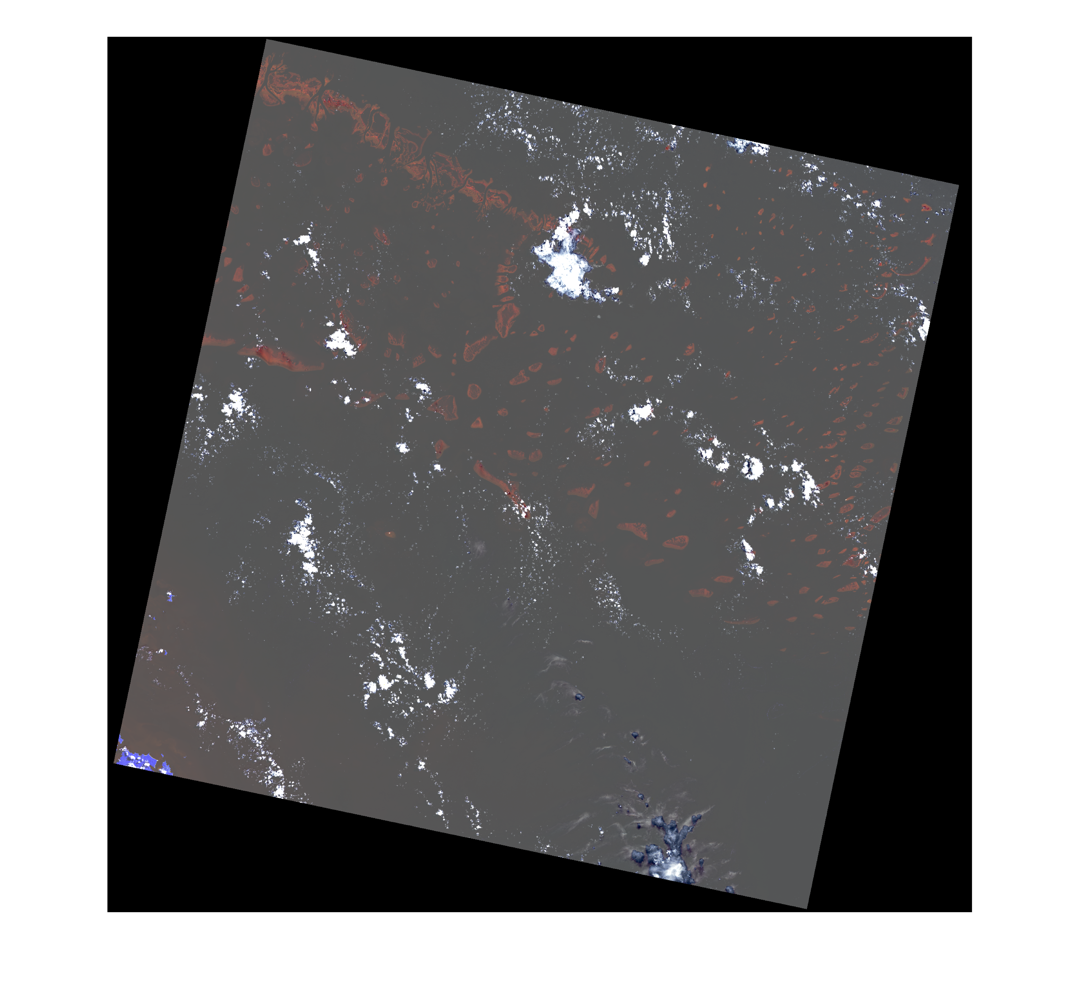
Infrared Colour
Makes the healthier vegetation appear more clearly in a brighter shade of red, in this case the corals.
It is also possible to notice pieces of land in blue in the bottom left of the image
Infrared Colour Bands(5,4,3)
Notes:
https://www.sciencedirect.com/topics/computer-science/chaotic-systems

Slide 26
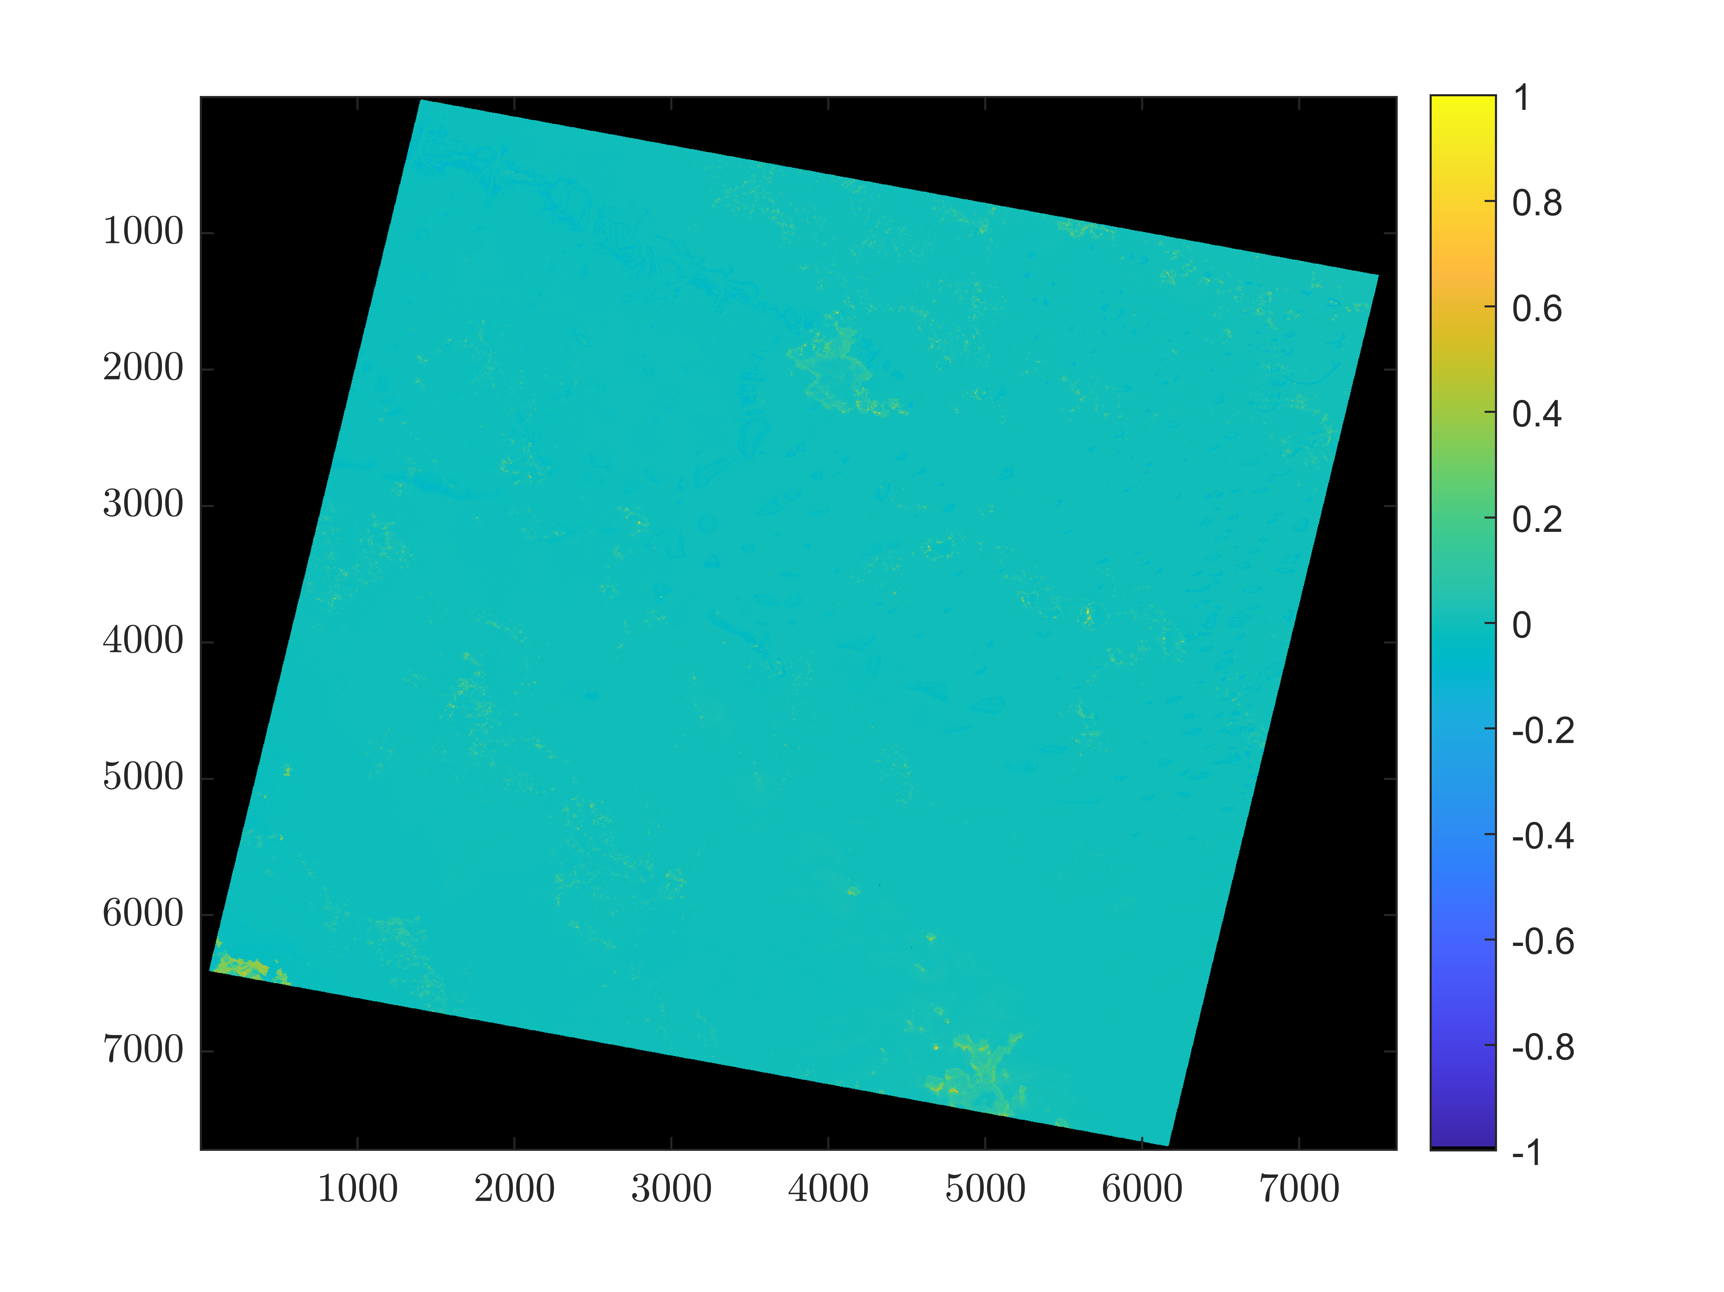
Normalized Difference Vegetation Index (NDVI)
Assesses whether or not the target being observed contains live green vegetation
This green vegeation appears mainly in the pieces of Land
NDVI
Bands(5,4)
Notes:
https://www.sciencedirect.com/topics/computer-science/chaotic-systems

Slide 27
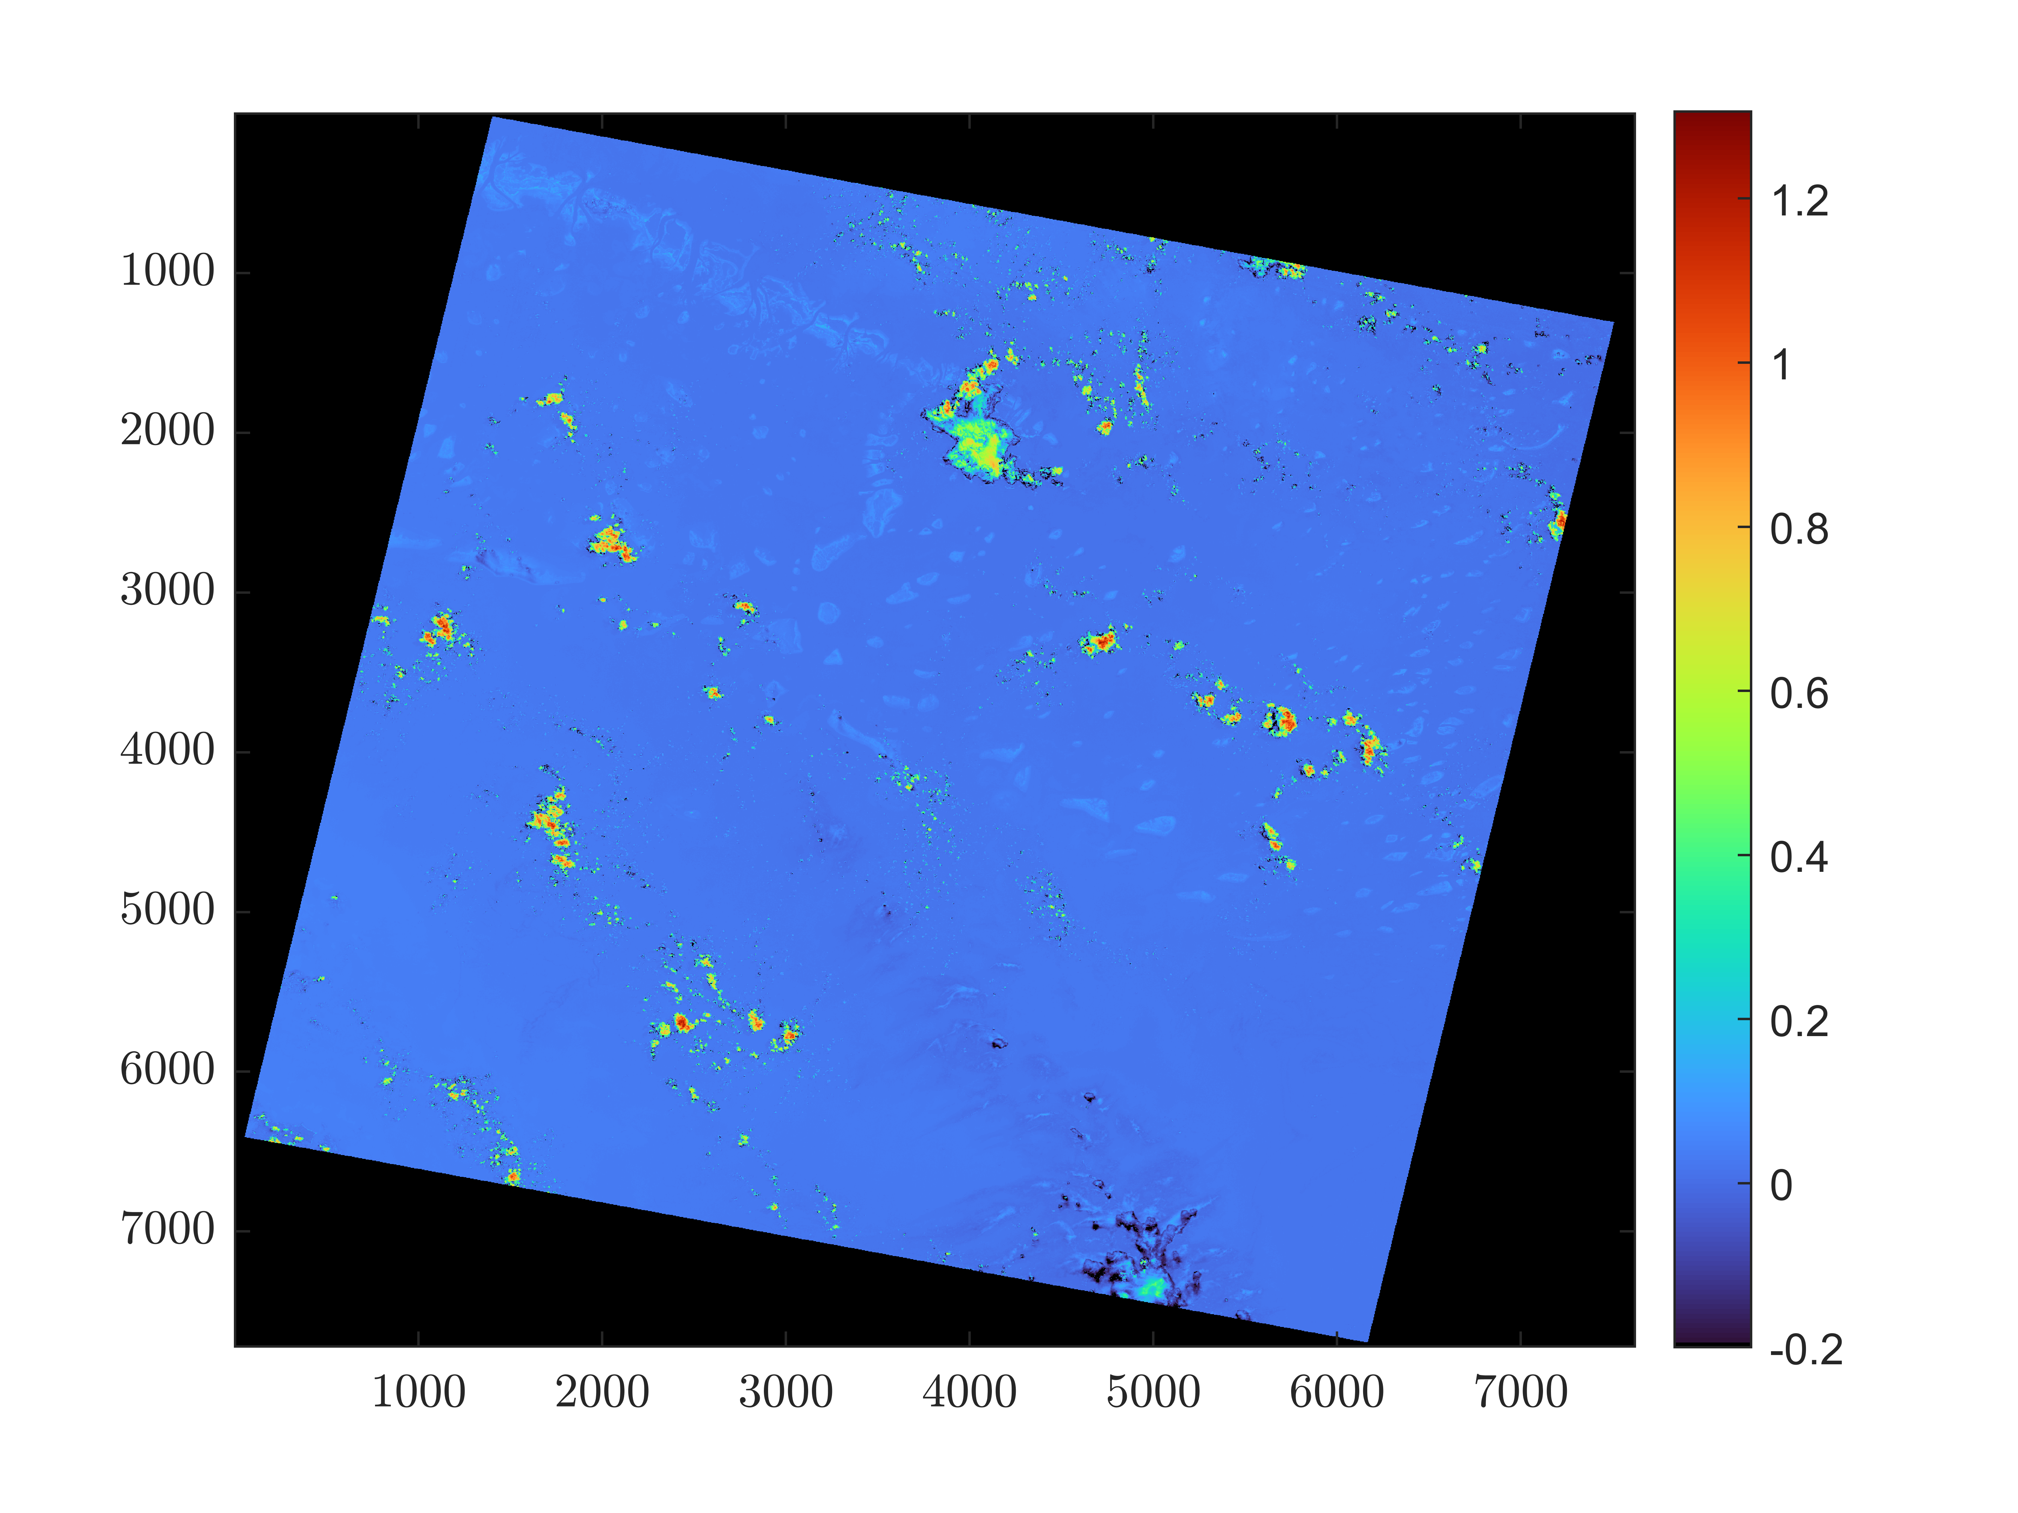
Remote Sensing Reflectance (Rrs)
Little bug in the bottom right of the image that in reality is a piece of land
Some regions that reflect more the others. However it does not give as much relevant information about the corals since the regions that reflect the most are mainly clouds.
Remote Sensing Reflectance (Rrs)
Bands(1)
Notes:
https://www.sciencedirect.com/topics/computer-science/chaotic-systems

Slide 28
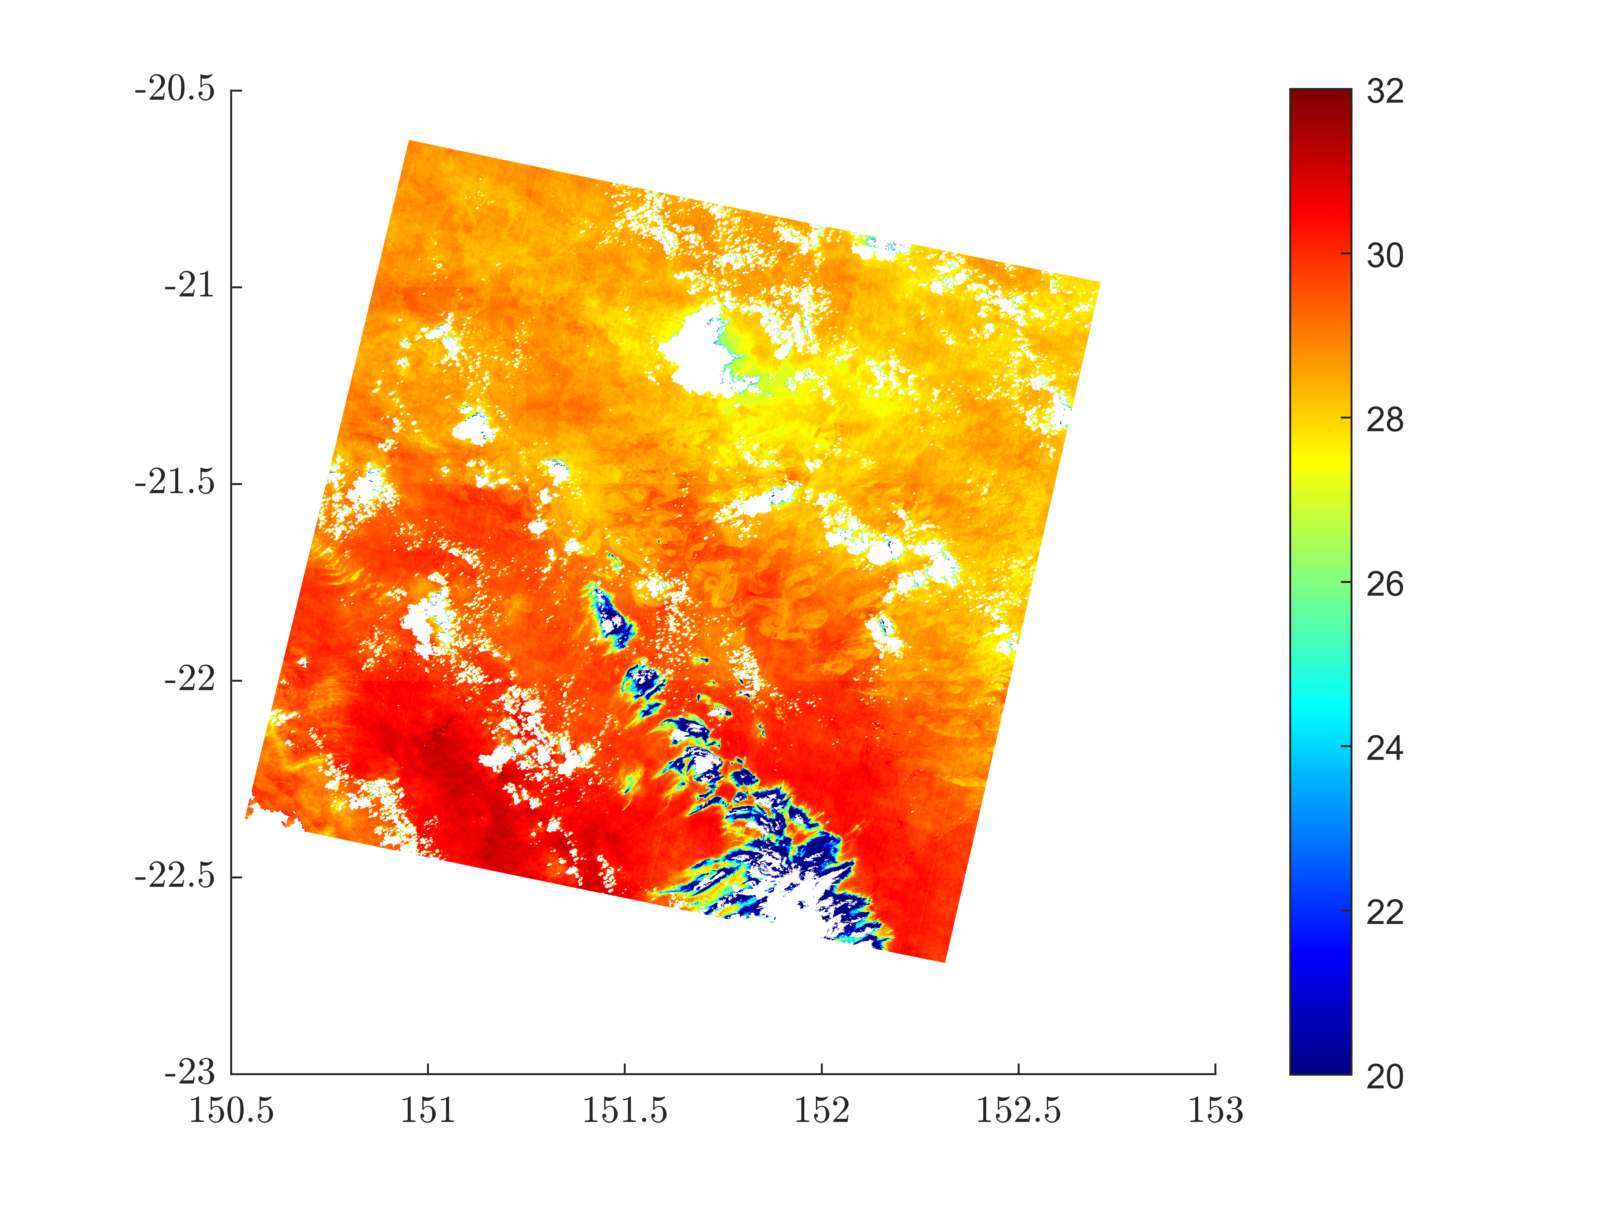
Geolocalized temperature map
Geolocalized temperature map algorithm uses a mask to show only the water temperature in different locations of the same region
Geolocalized Temperature Map
Bands (10,QA pixel)
Notes:
https://www.sciencedirect.com/topics/computer-science/chaotic-systems

Slide 29
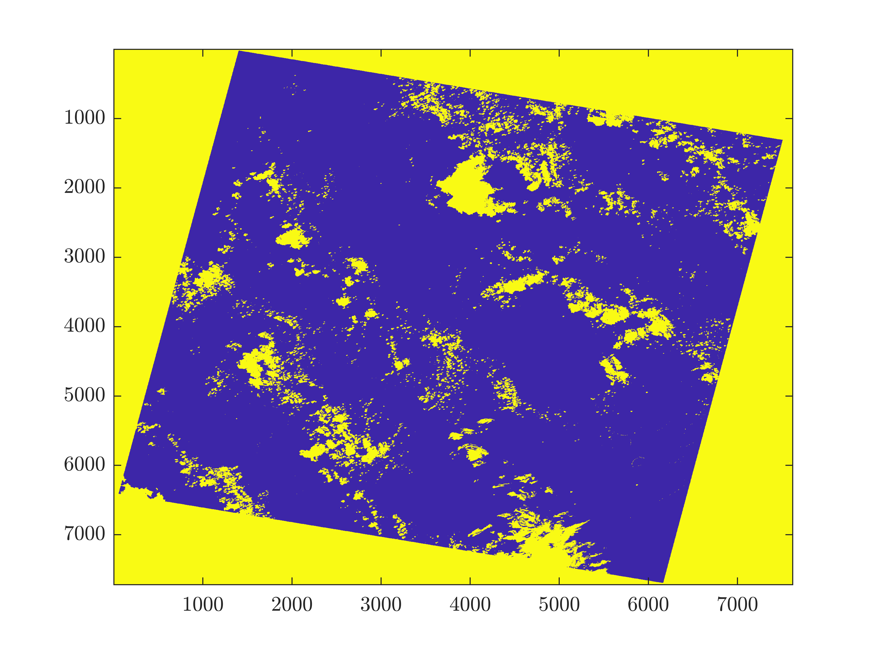
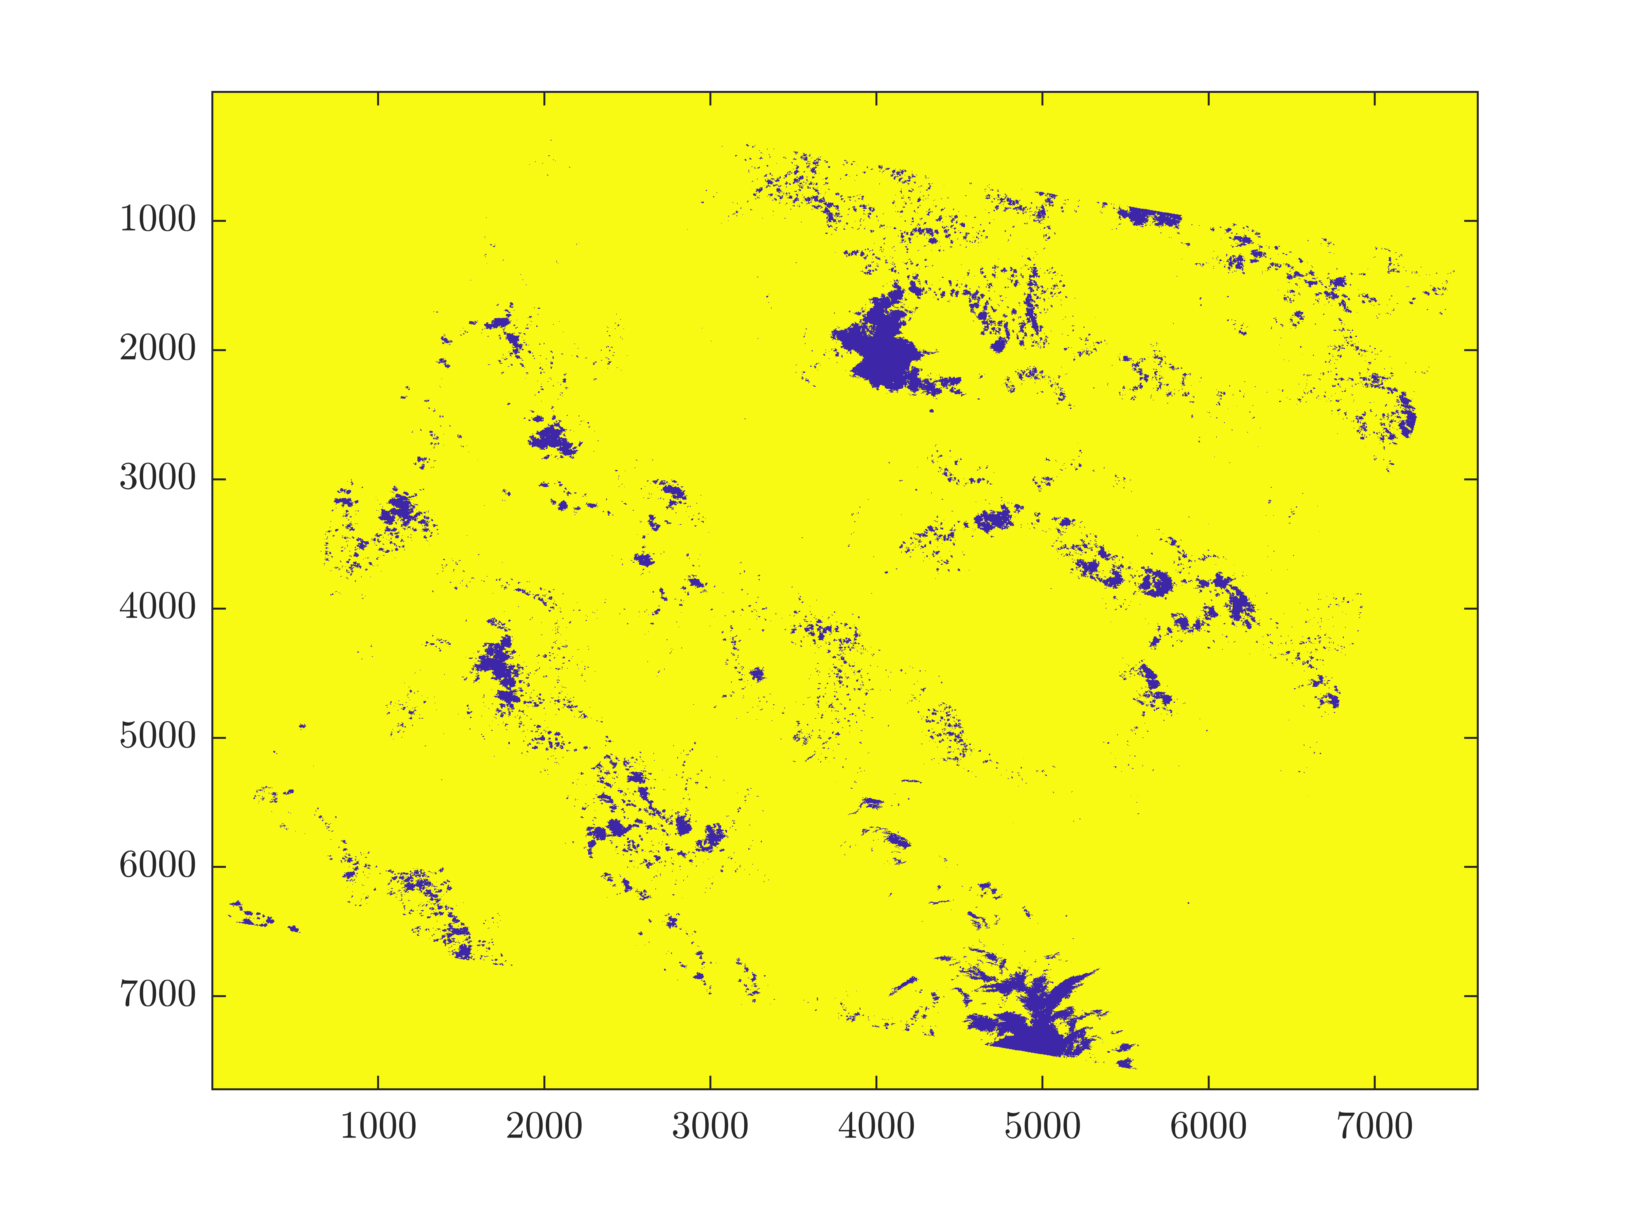
Water and Cloud Mask
Water Mask.
Yellow: Everything that is not water; Purple: Water.
Bands (10,QA pixel)
Cloud Mask.
Yellow: Everything that is not clouds; Purple: Clouds. Bands(10,QA pixel)
Notes:
https://www.sciencedirect.com/topics/computer-science/chaotic-systems

Slide 30
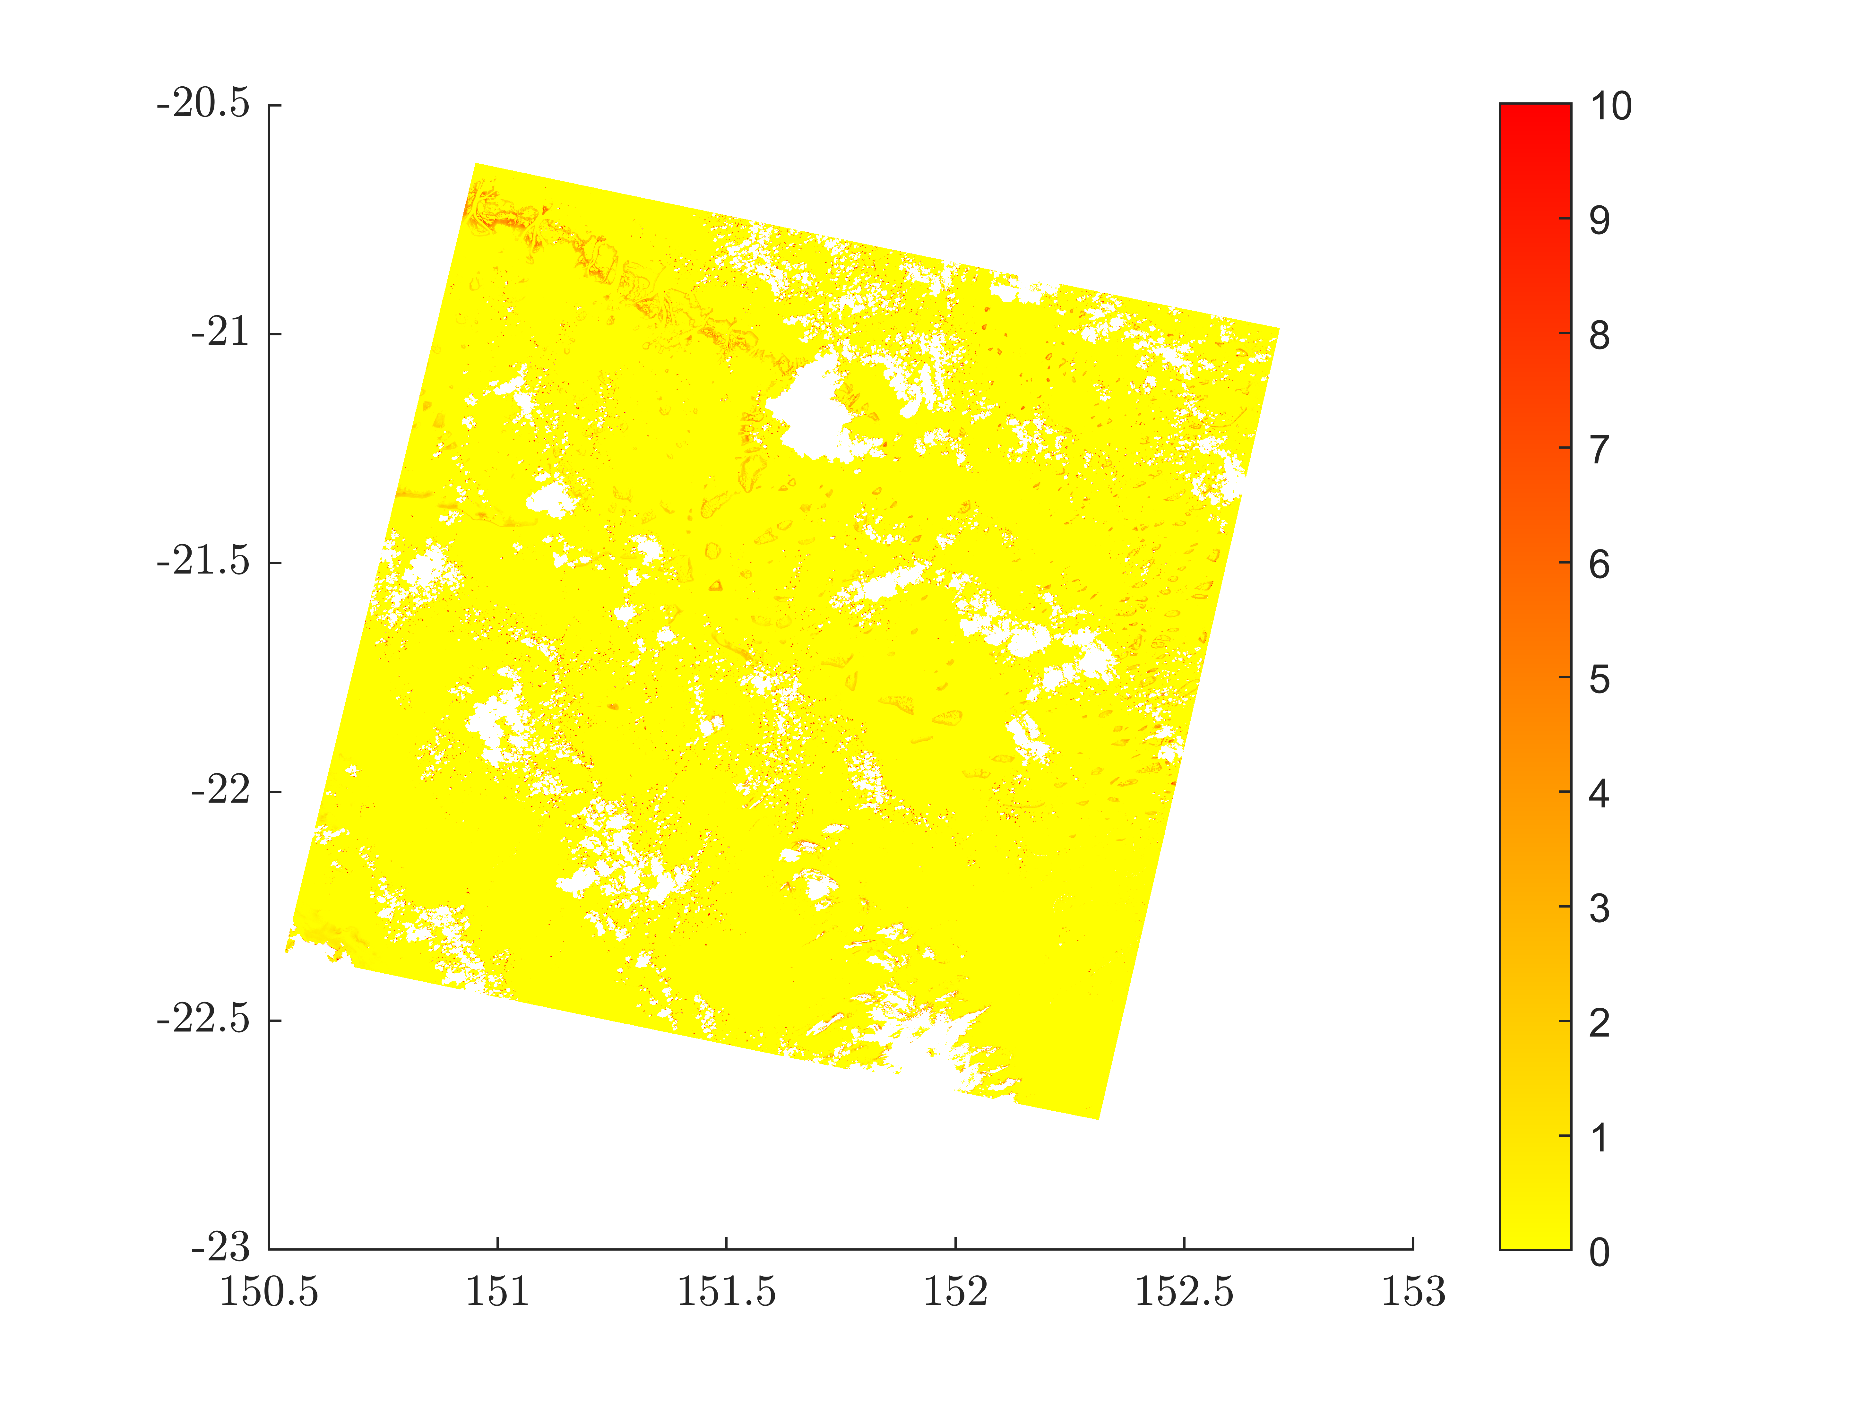

Turbidity
The turbidity is the measure of relative clarity of a liquid
The two algorithms used yield similar results
Lower turbidity in the water of the region, which indicates a good water quality.
Turbidity Vantrepotte
Bands (4,5,QA pixel)
Turbidity Dogliotti
Bands (4,5,QA pixel)
Notes:
https://www.sciencedirect.com/topics/computer-science/chaotic-systems

Slide 31
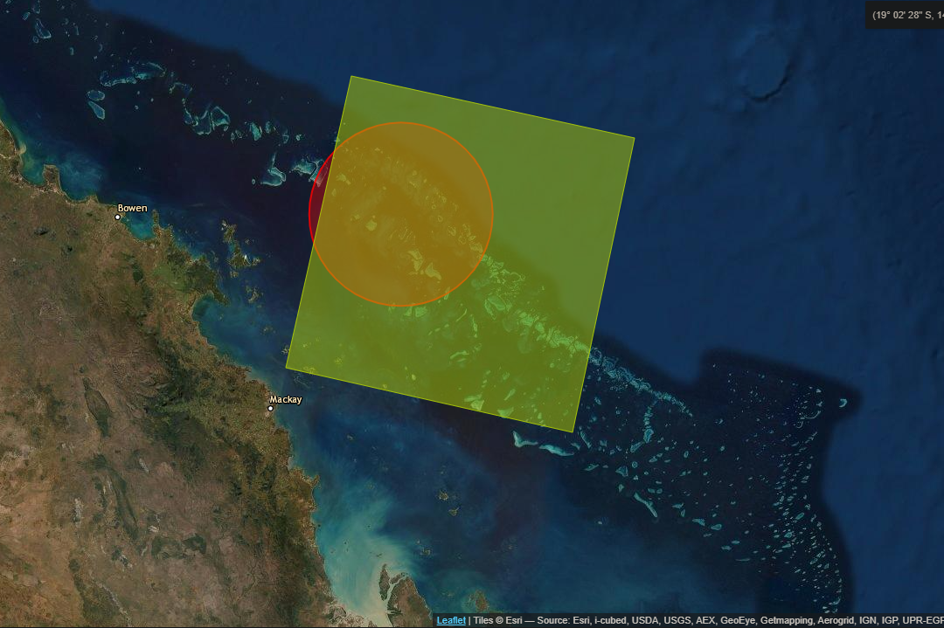
Problem definition for the Project
Understand what is really happening with these corals by analysing temperature and chlorophyll in Summer and Winter of the years 2005, 2010, 2015 and 2020.
December to February is summer
June to August is winter
Notes:
https://www.sciencedirect.com/topics/computer-science/chaotic-systems

Slide 32
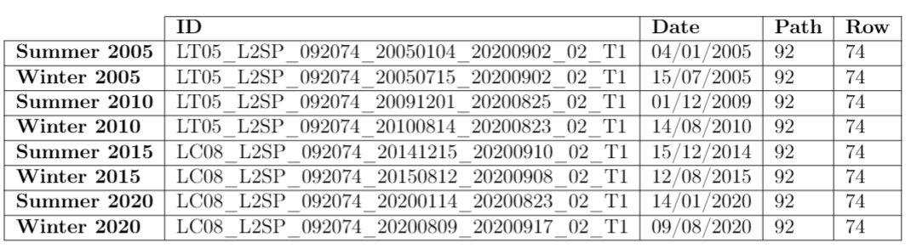
Data source for Project
Details about the data used in our project, including the path, row, date and ID for each year and season.
Notes:
https://www.sciencedirect.com/topics/computer-science/chaotic-systems

Slide 33
Natural Colour
False Colour
Combination of the visible red, green and blue bands
Resembles what would be observed naturally by the human eye: vegetation appears green, water dark is blue to black and bare ground and impervious surfaces appear light gray and brown.
Representation of a multispectral image produced using any bands other than visible red, green and blue.
Allow us to visualize wavelengths that the human eye can not see
Bands (3,2,1) for Landsat 5 (2005)
Bands (4,3,2) for Landsat 8 (2020)
Bands (5,4,3) for Landsat 5 (2005)
Bands (6,5,4) for Landsat 8 (2020)
Notes:
https://www.sciencedirect.com/topics/computer-science/chaotic-systems

Slide 34
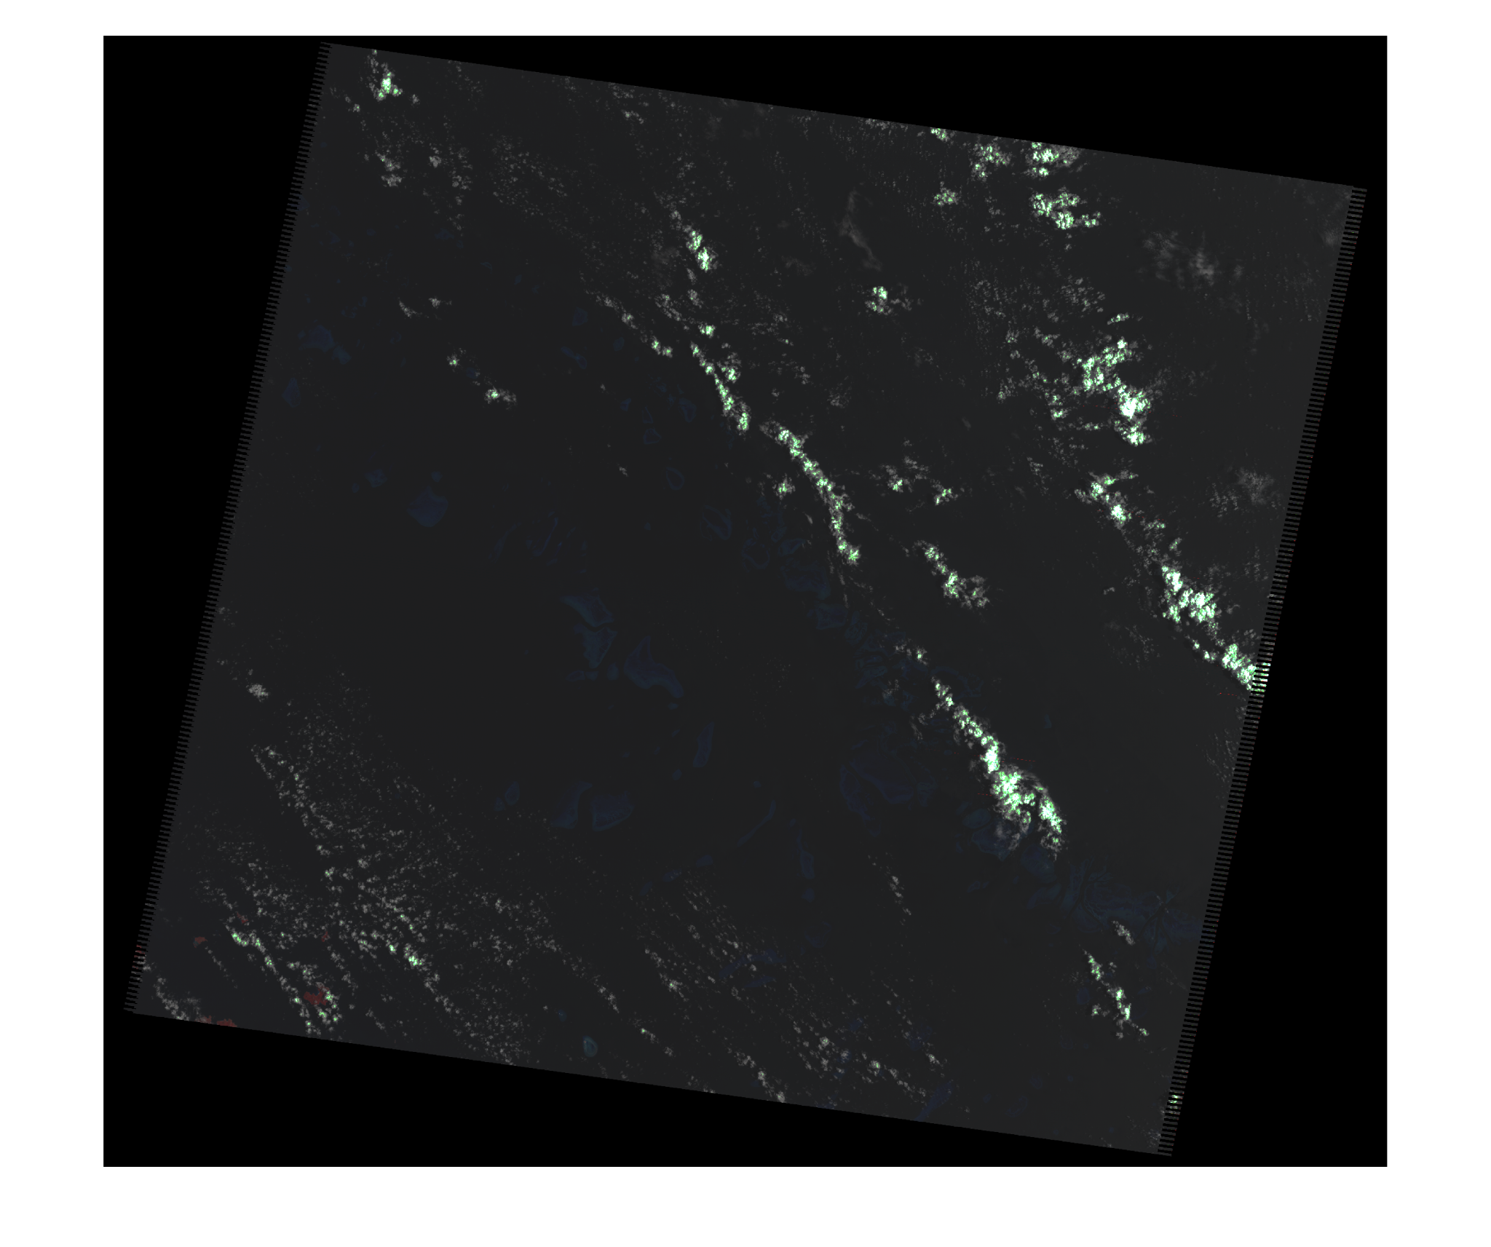
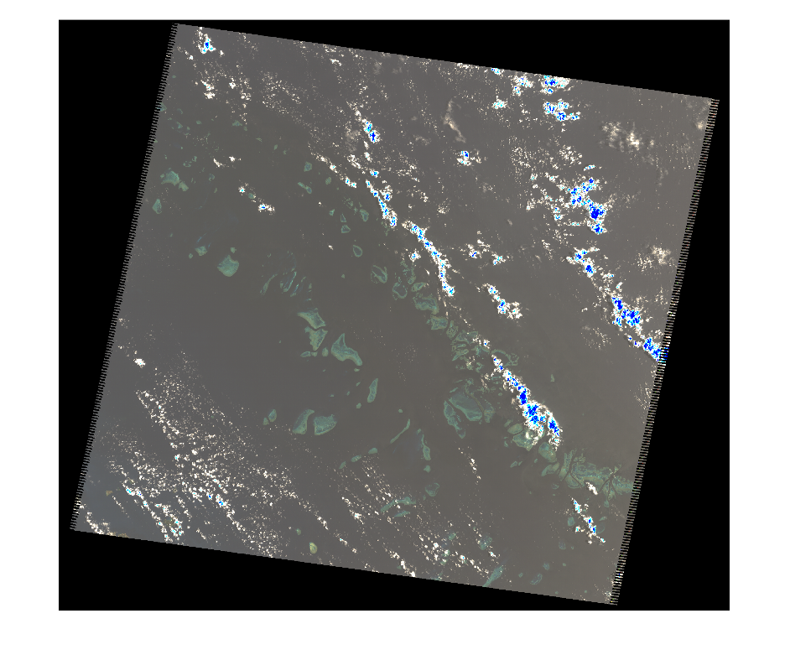
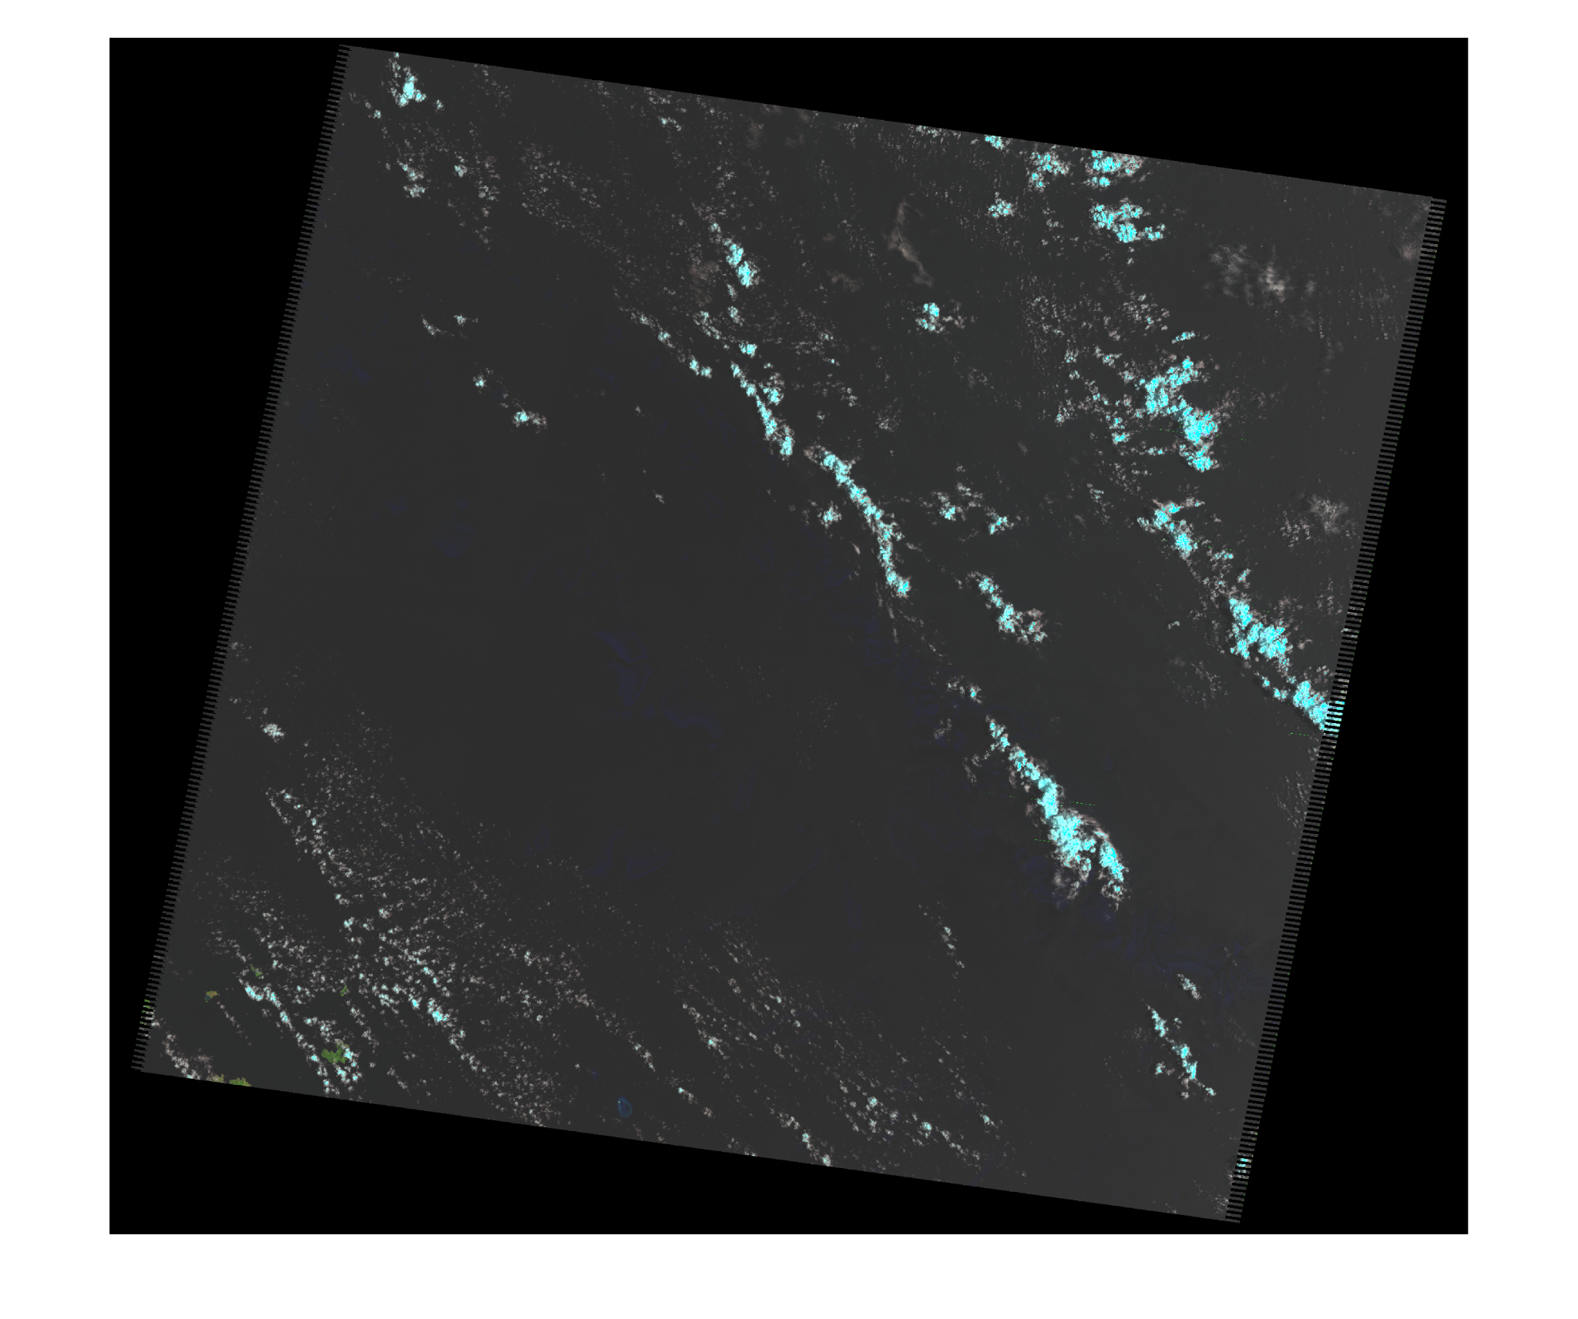
Summer 2005
Original to Natural Colour: More visible corals
Original to False Colour: Not many conclusions to take
Original
Natural colour
False colour

Slide 35
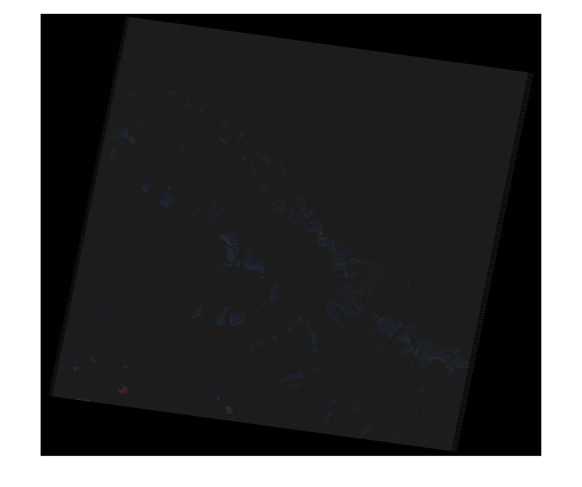
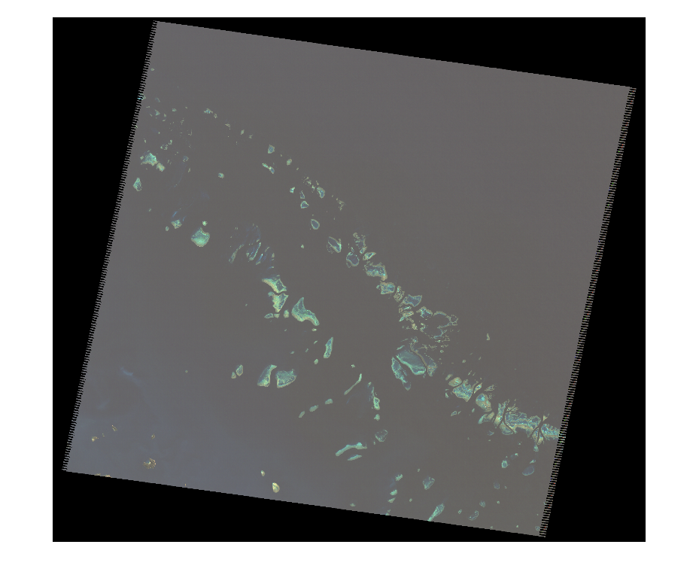
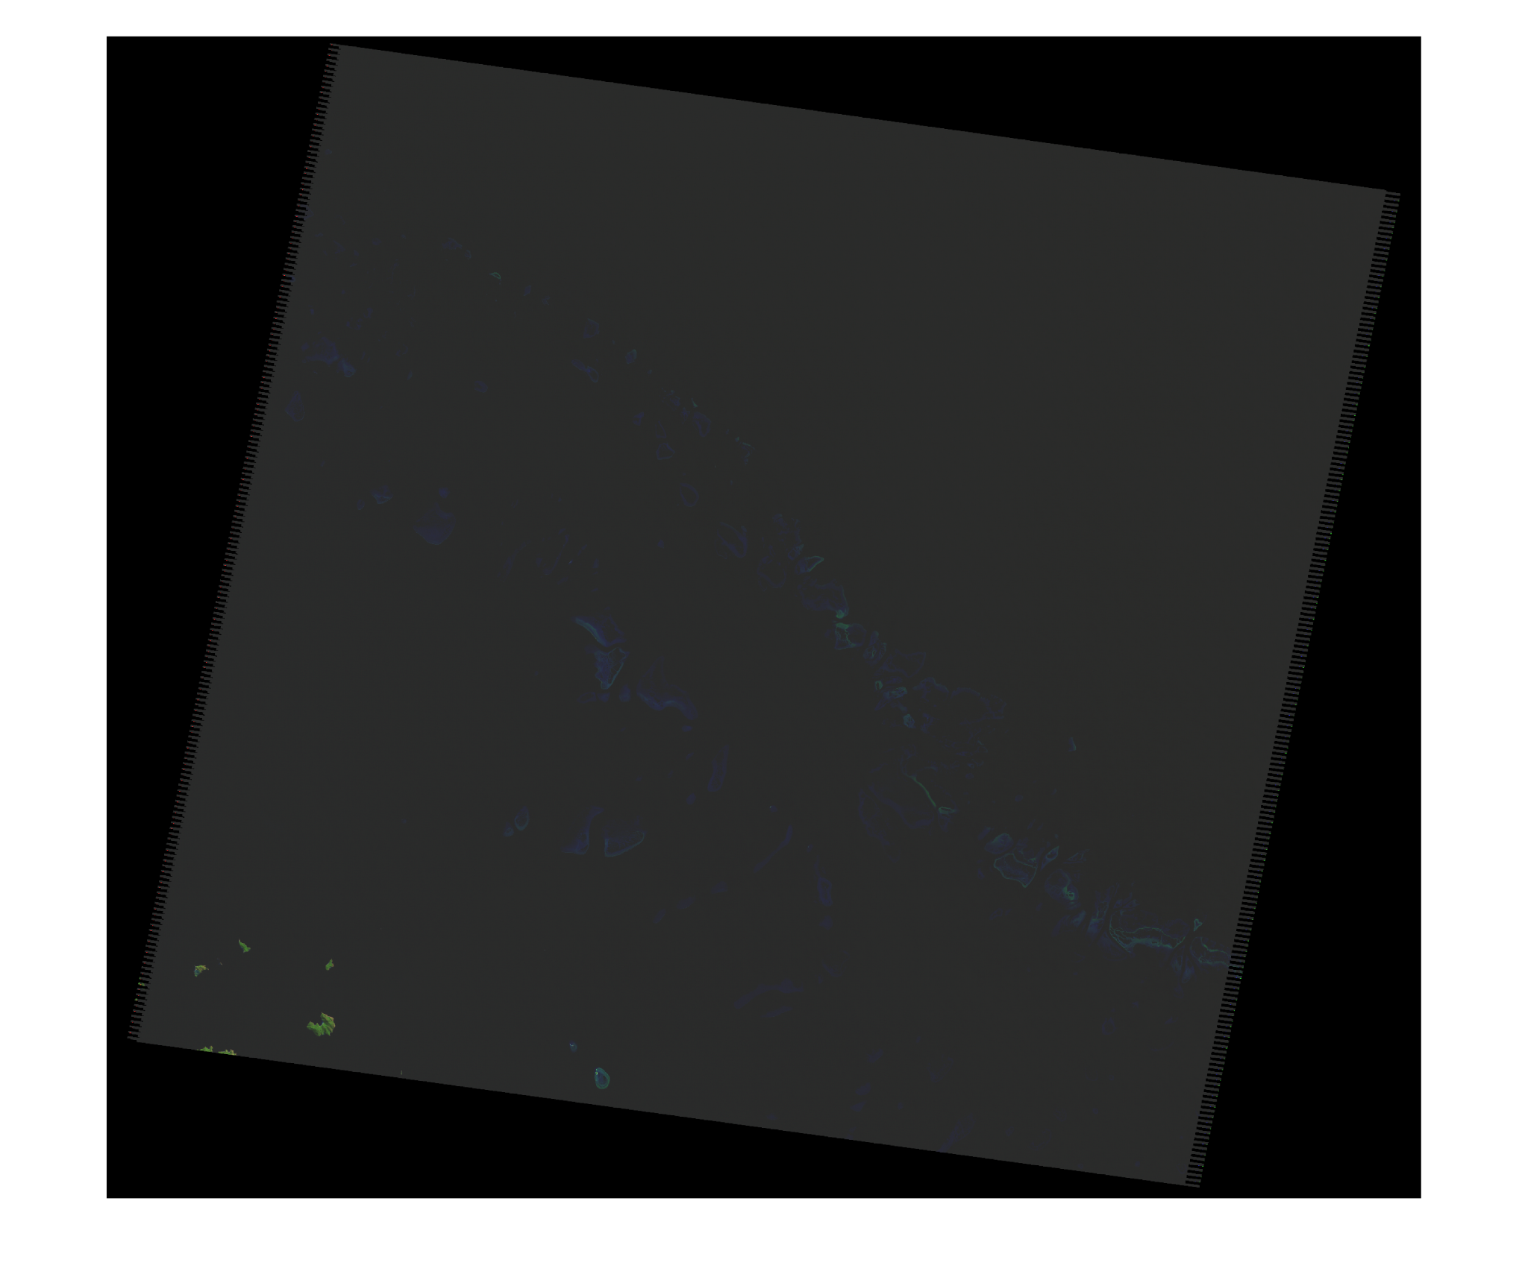
Winter 2005
Original to Natural Colour: a little more visible corals
Original to False Colour: Highlights a little bit the land in the left corner
Original
Natural colour
False Colour Colour

Slide 36
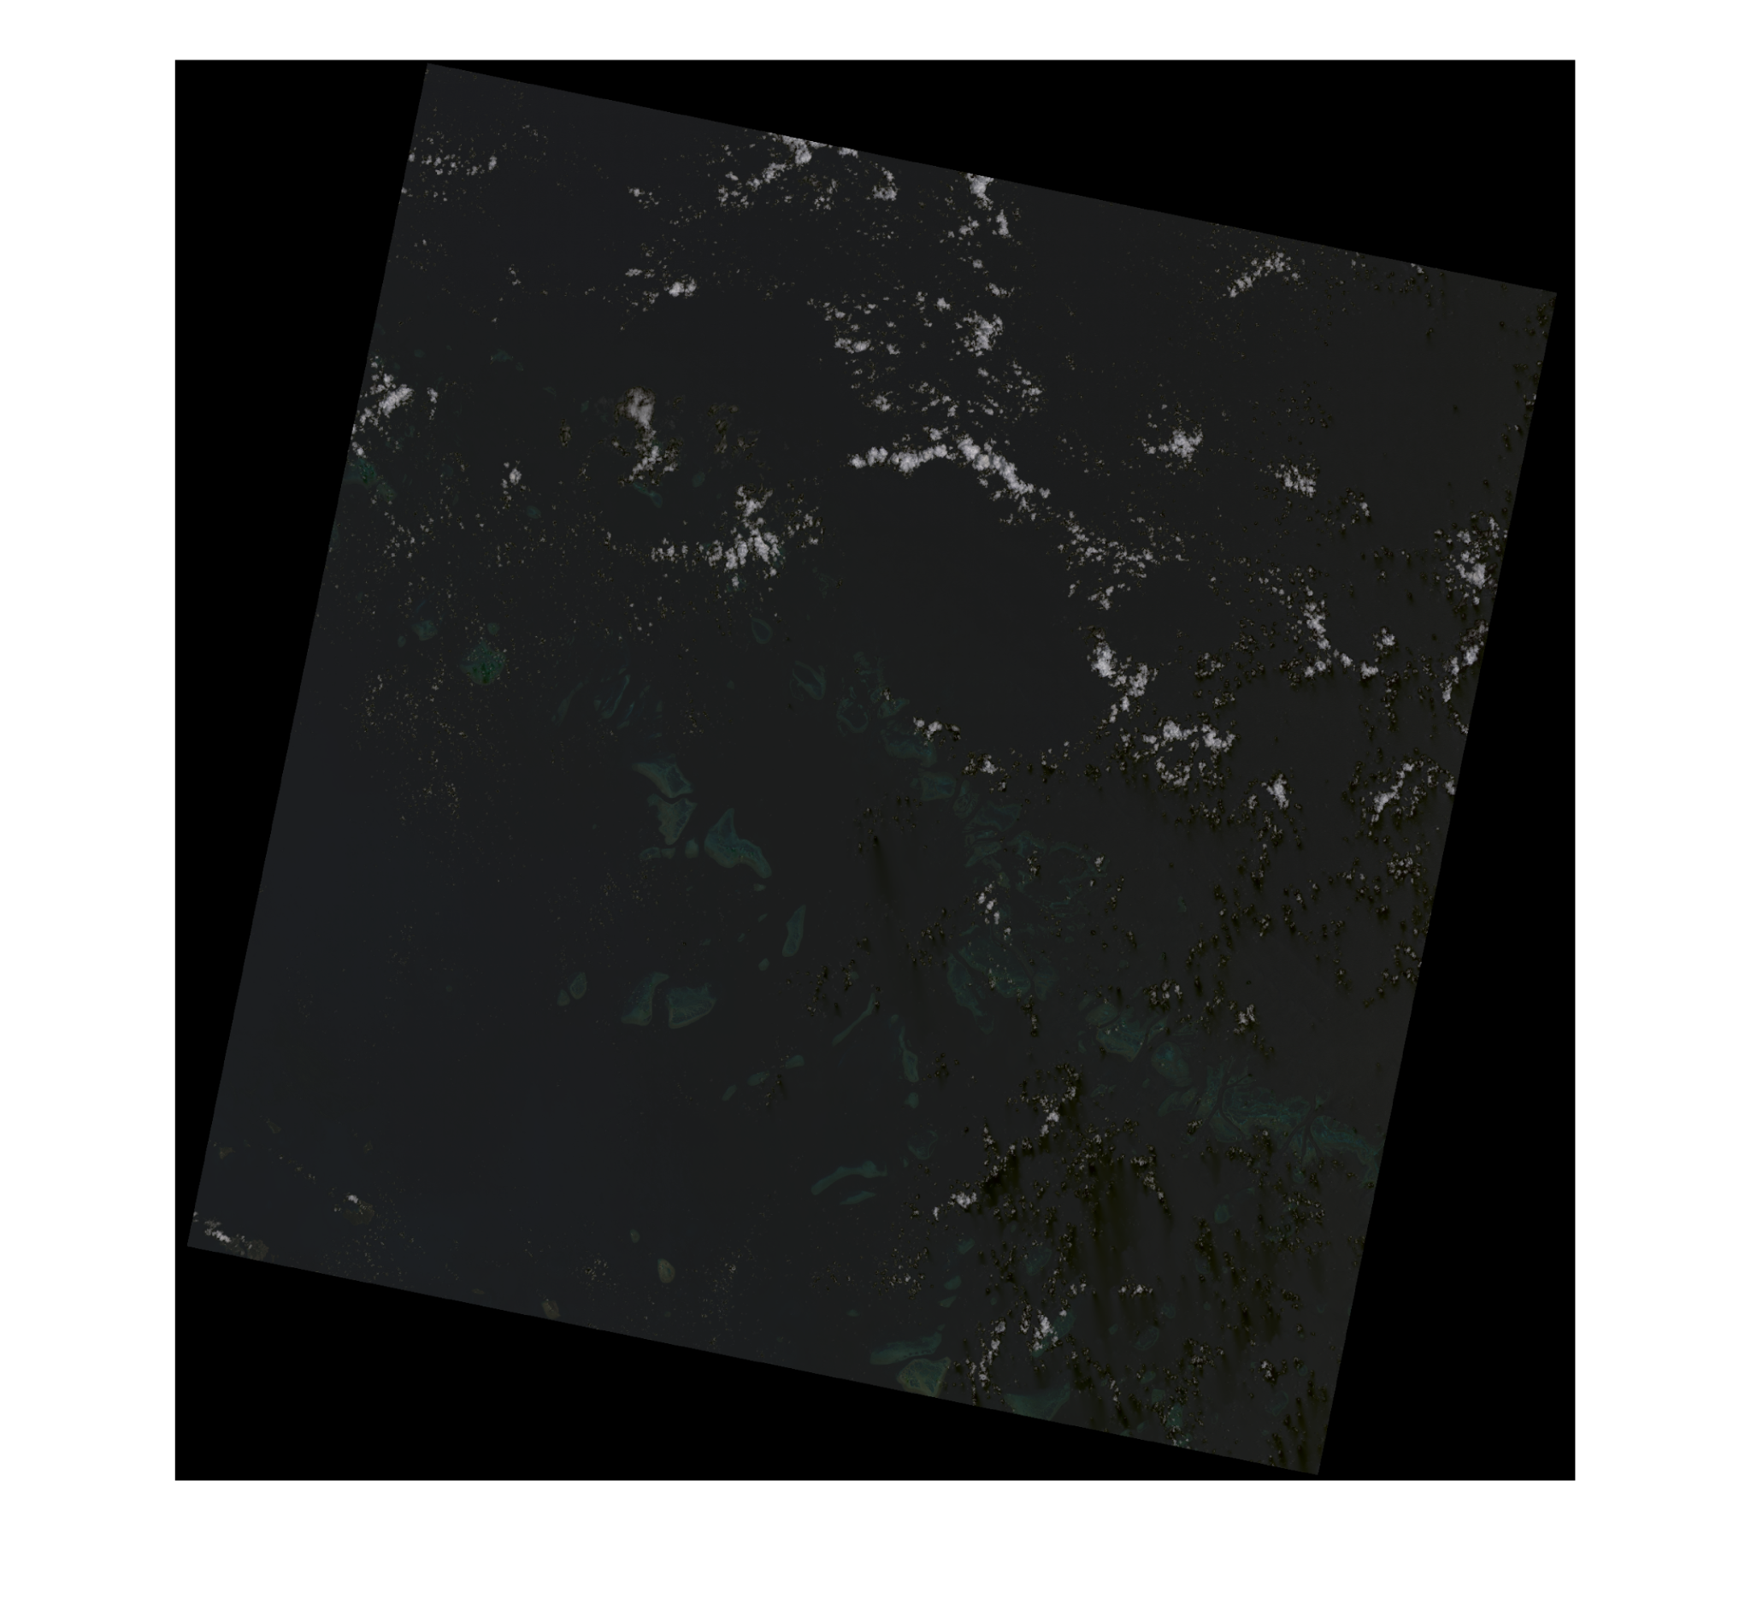
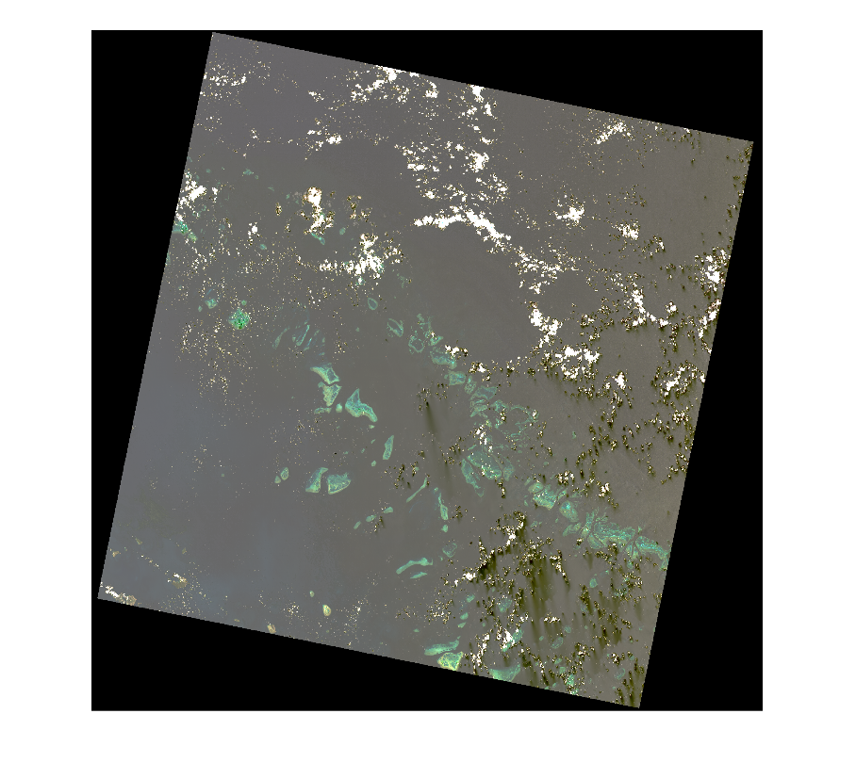
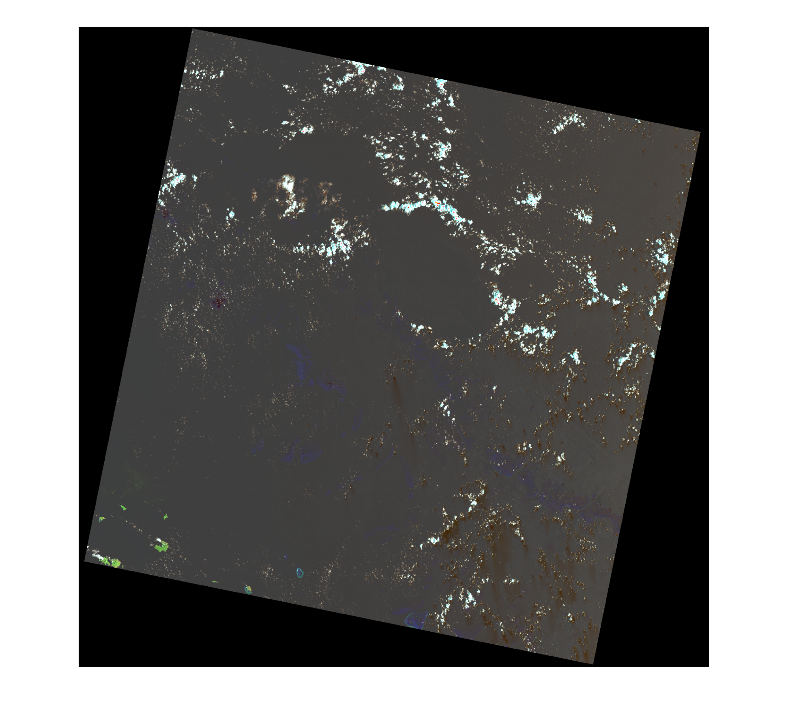
Summer 2020
Original to Natural Colour: More visible corals
Original to False Colour: Highlights a little bit the land in the left corner
Original
Natural colour
False Colour

Slide 37
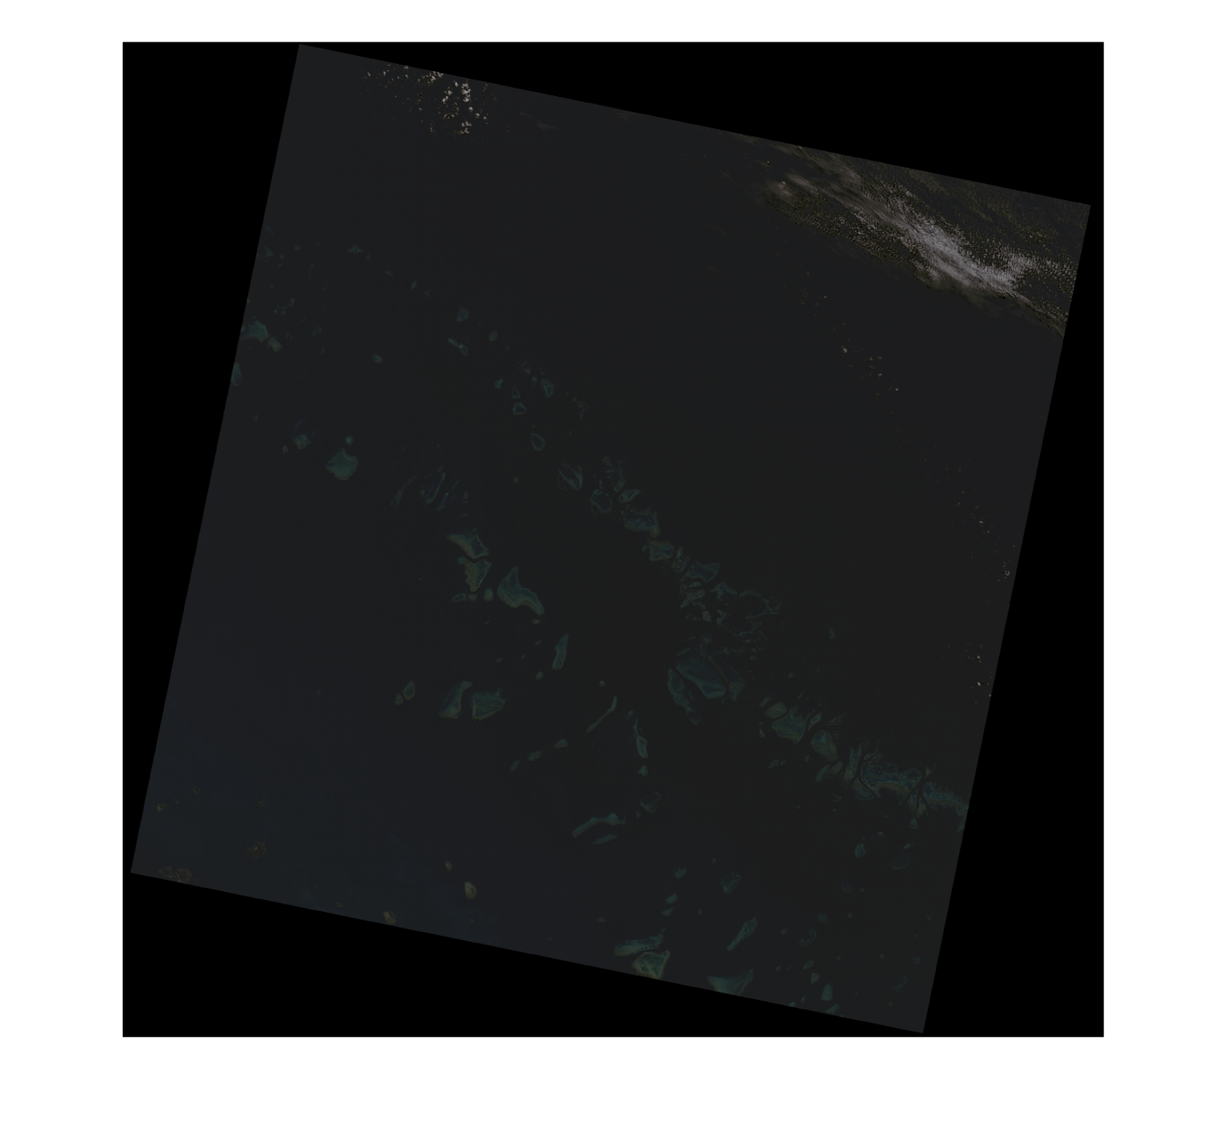
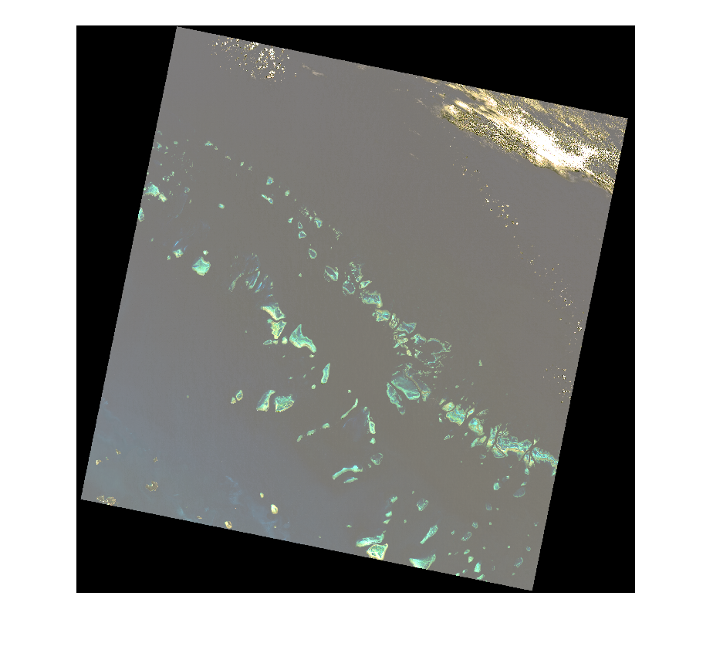
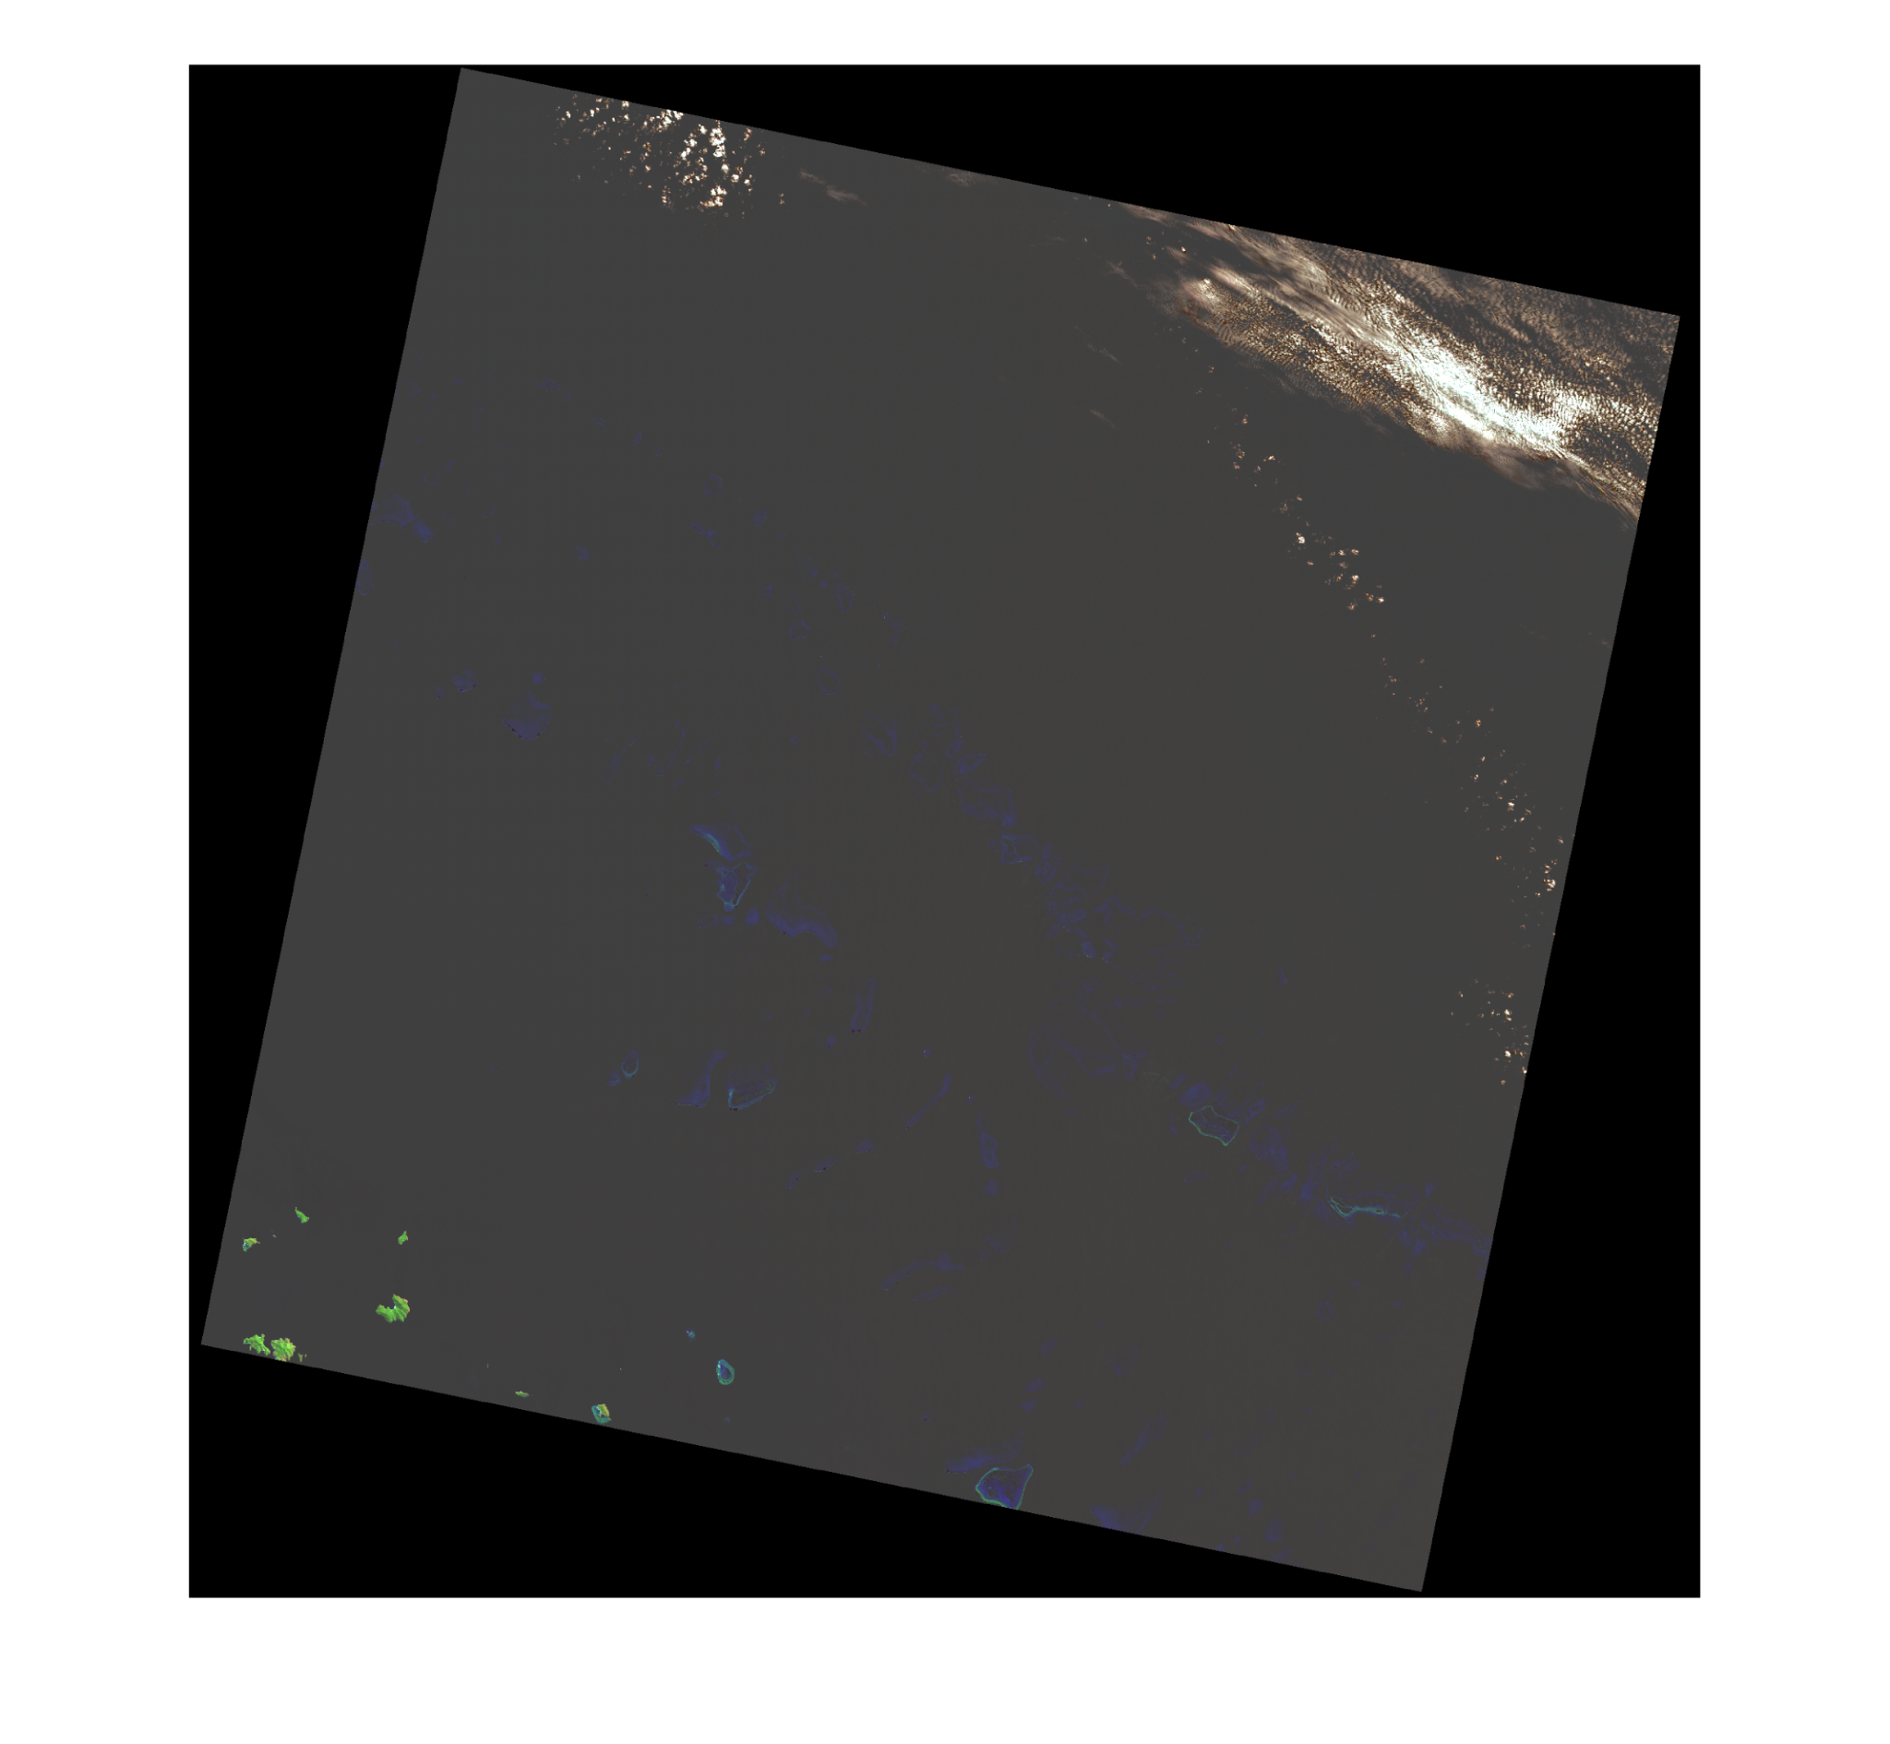
Winter 2020
Original to Natural Colour: Clearly visible corals
Original to False Colour: Highlights a lot the land in the left corner
Original
Natural colour
False Colour

Slide 38
Temperature
Chlorophyll
Band 6 for Landsat 5 (2005 and 2010)
Band 10 for Landsat 8 (2015 and 2020)
Temperature Algorithm
Bands (1,2,3) and QA for Landsat 5 (2005 and 2010) and for Landsat 8 (2015 and 2020)
Chlorophyll Algorithm

Slide 39
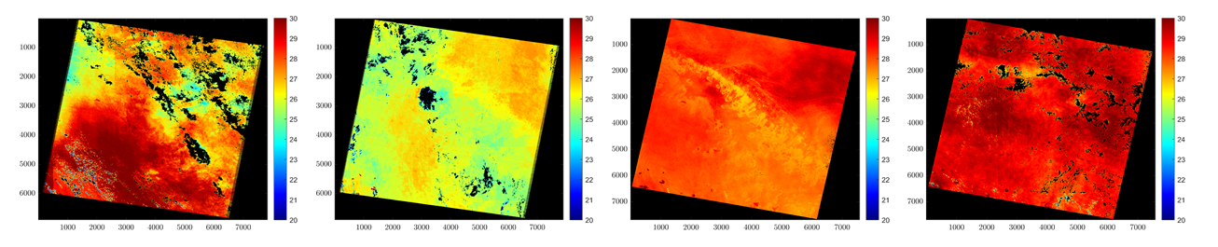
Temperature (Summer)
2005 to 2010: La Niña Phenomenon Climate pattern that describes an unusual cooling of the region’s surface in the central and eastern tropical Pacific Ocean
2010 to 2015: El Niño Phenomenon Climate pattern that describes an unusual warming of the region’s surface in the central and eastern tropical Pacific Ocean
2005
2010
2015
2020
Notes:
https://www.sciencedirect.com/topics/computer-science/chaotic-systems

Slide 40
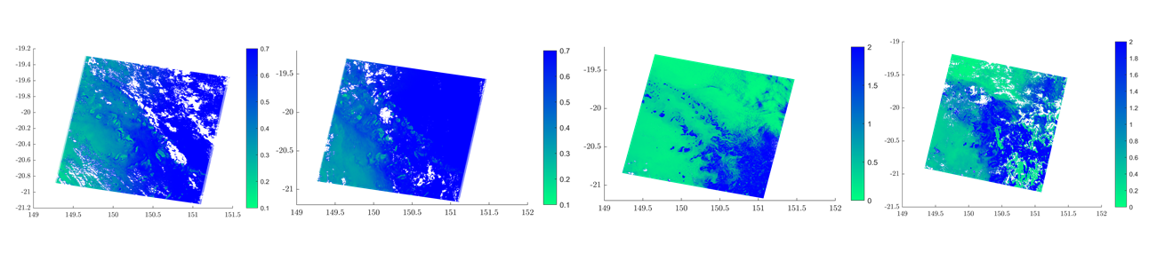
Chlorophyll (Summer)
Coral bleaching happens when the corals are stressed by changes in conditions such as temperature, light or nutrients.
Situations of extreme changes in the temperatures, the corals expel the symbiotic algae called zooxanthellae living in their tissues causing them to turn completely white.
La Nina and El Nino phenomenon one after another led to Coral Bleaching in 2010.
In 2015 and 2020 higher concentrations of chlorophyll.
2005
2010
2015
2020
Notes:
https://www.sciencedirect.com/topics/computer-science/chaotic-systems

Slide 41

Temperature (Winter)
Summer to Winter there is a sharp drop of temperature of approximately 5º which is normal.
no very marked differences from year to year
2005
2010
2015
2020
Notes:
https://www.sciencedirect.com/topics/computer-science/chaotic-systems

Slide 42

Chlorophyll (Winter)
No major differences from 2005 to 2010 and the corals have the highest concentration comparing to the surroundings.
Higher concentrations of chlorophyll in 2015 and 2020 (as seen in the summer).
2005
2010
2015
2020
Notes:
https://www.sciencedirect.com/topics/computer-science/chaotic-systems

Slide 43
“Our Reef is still beautiful but we need urgent action on climate change to give it the best chance for the future. ”
Notes:
https://www.sciencedirect.com/topics/computer-science/chaotic-systems

Slide 44

Cassini Jupiter flyby
A5 – Open Assignment SPICE
[1] Cassini Jupiter Portrait. https://www.jpl.nasa.gov/images/cassini-jupiter-portrait

Slide 45

Original image of Jupiter
Image taken by Cassini-Huygens
(2000/10/01)
Exposure duration = 320 s
Instrument name =
“Imaging Science Subsystem Narrow-Angle"
N1351738505_2.IMG [1]
[1] Cassini Jupiter Image. https://pds-rings.seti.org/holdings/volumes/COISS_1xxx/COISS_1002/data/1351738505_1351858128/N1351738505_2.IMG

Slide 46

Theoretical position of Jupiter
Image taken by Cassini-Huygens
(2000/10/01)
Pixels outside Jupiter: Black
Pixels inside Jupiter: Blue
Parameters
Ellipsoid method
LT aberration correction
N1351738505_2.IMG

Slide 47


Longitude/Latitude map
2000-306T02:44:03.167
2000-306T07:40:24.455
N1351738505_2.IMG
N1351756287_2.IMG
The validation of a giant gas planet such as Jupiter can not be pursued using previous images as with rocky planets.
The images represent subsequent photographs of the same area with the same spectre.
Cassini Jupiter Image. https://pds-rings.seti.org/holdings/volumes/COISS_1xxx/COISS_1002/data/1351738505_1351858128/N1351744287_2.IMG

Slide 48



Conclusions
A4 – A6 Endangered coral reef with Landsat images
A2 Pluto’s hazy blue
atmosphere
A3 Linda Morabito’s
Discovery [1]
A5 Jupiter’s ever changing sight
[1] Stern, A., & Grinspoon, D. (2018). Chasing New Horizons: Inside the Epic First Mission to Pluto. Picador.

